Slide 1

Kher Wallet
Supervised by:
Dr. Khaled Wassif
TA. Ashraf Mohey
Implemented by:
ID | Name
20186031 | Nada Mohamed
20186008 | Sarah Khaled
20186043 | Mark Rofaeel
20186007 | Ayat Hany
20186049 | Yasmine Shehab
Graduation Project
Academic Year 2021-2022
Midyear Presentation

Slide 2
TABLE OF CONTENTS
01
02
03
Project idea
Problem significance
Project specifications
Idea description and
domain of interest.
Problems to be solved.
Requirements and important diagrams.
04
05
06
Time plan
Demo
Conclusion
Tasks to be fulfilled.
Successive screenshots of our application.
Conclusion to what we have said.

Slide 3

Project idea
01
Idea description and
domain of interest.

Slide 4
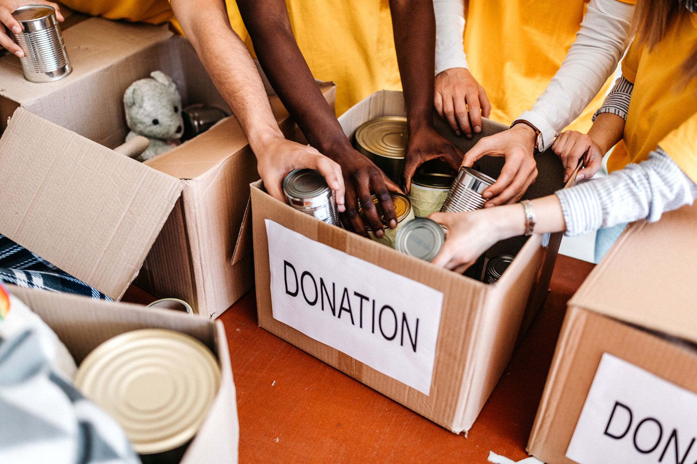
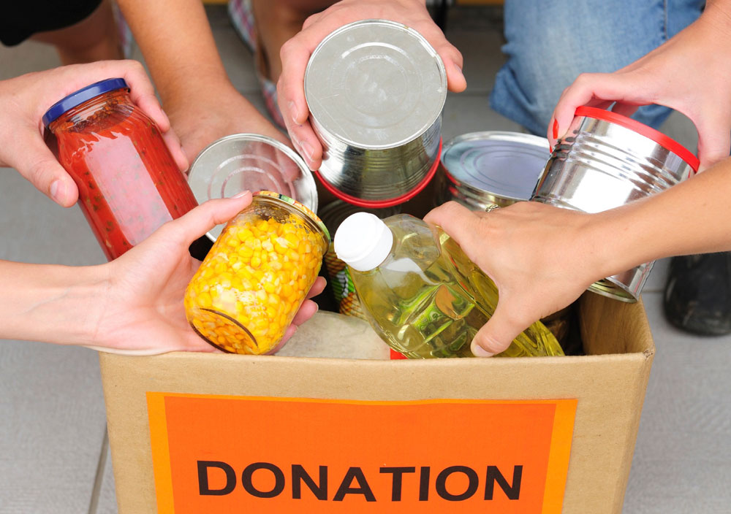
Project idea
Nowadays, there are a lot of organizations that accept donations from different people.
It takes time and effort for people to reach to these organizations so they can donate.
So, our project idea is to solve this problem by implementing an application that help people to donate in an easier way and notify when there is a new post or event around the corner.

Slide 5
TABLE OF CONTENTS
01
02
03
Project idea
Problem significance
Project specifications
Idea description and
domain of interest.
Problems to be solved.
Requirements and important diagrams.
04
05
06
Time Plan
Demo
Conclusion
Tasks to be fulfilled.
Successive screenshots of our application.
Conclusion to what we have said.

Slide 6
Problem significance
02
Problems to be solved.

Slide 7
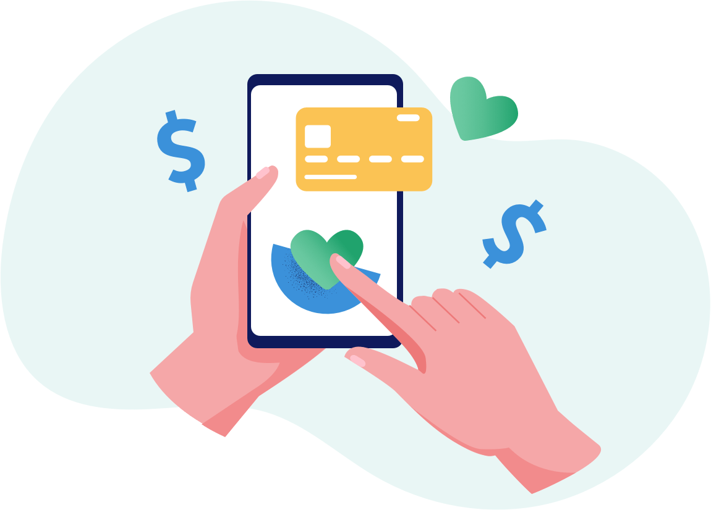
Problem significance
Our problem is that people spend so much time and effort to reach different organizations that has led to the shortage of the overall amount of donations.
Other problem is that those organizations do not have the capability to reach large amount of people to help in notifying them with events.

Slide 8
TABLE OF CONTENTS
01
02
03
Project idea
Problem significance
Project specifications
Idea description and
domain of interest.
Problems to be solved.
Requirements and important diagrams.
04
05
06
Time Plan
Demo
Conclusion
Tasks to be fulfilled.
Successive screenshots of our application.
Conclusion to what we have said.

Slide 9
03
Project specifications
Requirements and important diagrams.

Slide 10




Functional requirements
Donator’s functionalities
Sign up
Sign out
Using own their personal information.
At any given time, a donator can sign out.
Sign in
Forget password
Using email and password.
An email will be sent where password can be easily reset.

Slide 11



Functional requirements
Donator’s functionalities
Write feedback
Contact us
Write a feedback of his own.
Contact us to solve any problem via email.
Request help
Frequently asked questions with provided answers.

Slide 12


Functional requirements
Donator’s functionalities
Update donator’s profile
View posts
Any information in profile.
The upcoming posts where help is needed.
View notifications
Whenever a new place is added, or when there is an event where help is needed.

Slide 13



Functional requirements
Donator’s functionalities
Expand event description
Filter posts/events
Filter posts based on organization name
About a specific event with full description.
Apply to a post/event
Through a Google form, a donator can apply to post/event

Slide 14


Functional requirements
Donator’s functionalities
Donate
Remove from requests
By requesting a representative.
Remove donations from requests.
View requests
View different donations in requests.

Slide 15
Functional requirements
Organization’s functionalities
Sign in
Sign out
Using email and password.
At any given time, a organization can sign out.
Forget password
An email will be sent where password can be easily reset.

Slide 16

Functional requirements
Organization’s functionalities
Add post
Remove post
Any upcoming post which is then send as a notification to donators.
Remove existing post
Update post
Update existing post such as event code or details

Slide 17
Functional requirements
Organization’s functionalities
Update organization’s profile
Expand post description
Any information in profile.
About a specific event with full description.
View posts
The posts already has been posted.

Slide 18

Functional requirements
Organization’s functionalities
View requests
Analyze data
View the requests made by donators.
A pie chart is generated with the data available.
Edit requests
Edit any request’s current state.

Slide 19
Functional requirements
Organization’s functionalities
Write feedback
Contact us
Write a feedback of his own.
Contact us to solve any problem via email.
Request help
Frequently asked questions with provided answers.

Slide 20


Non-functional requirements
Portability
Usability
01
02
Run on both Android and iOS devices.
Determine what a feature is and what it can do.
Non-functional
Availability
Response time
Available to use 24/7.
03
04
Load at not more than 5 seconds.

Slide 21




Non-functional requirements
Authorization
Authentication
05
06
Specific email and password is given to organizations.
Using Google’s Firebase Authentication technology.
Non-functional
Scalability
Security
More requests and data can be handled.
07
08
Email, password, number, terms of services and private policy.

Slide 22
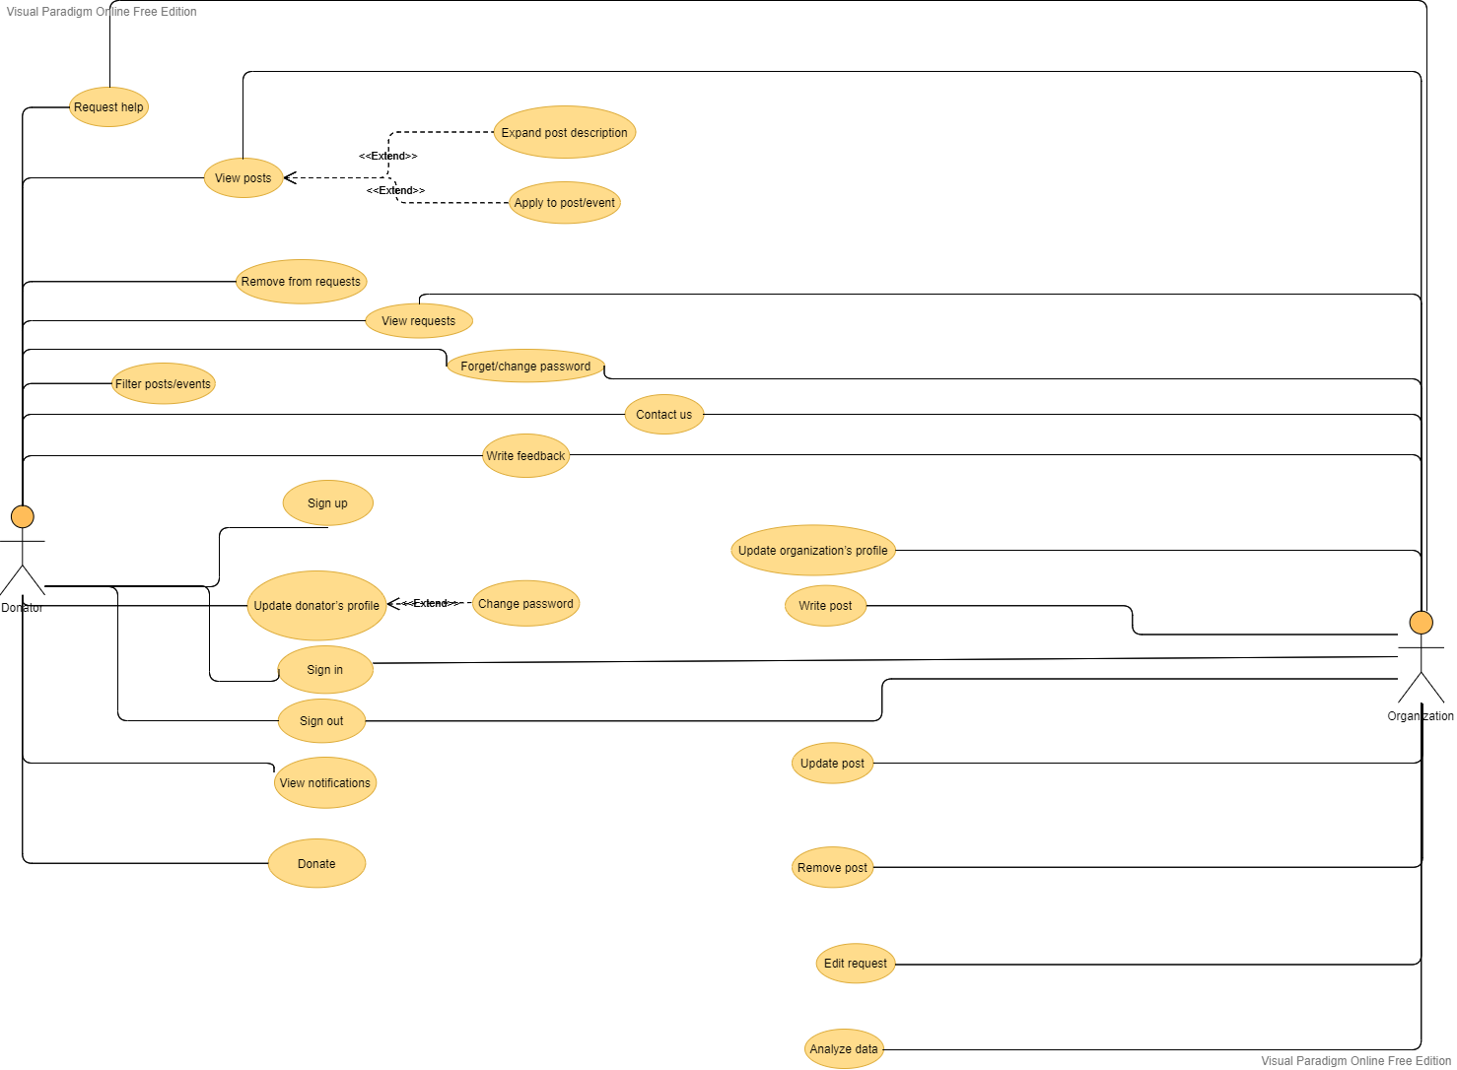
Use-case Diagram

Slide 23
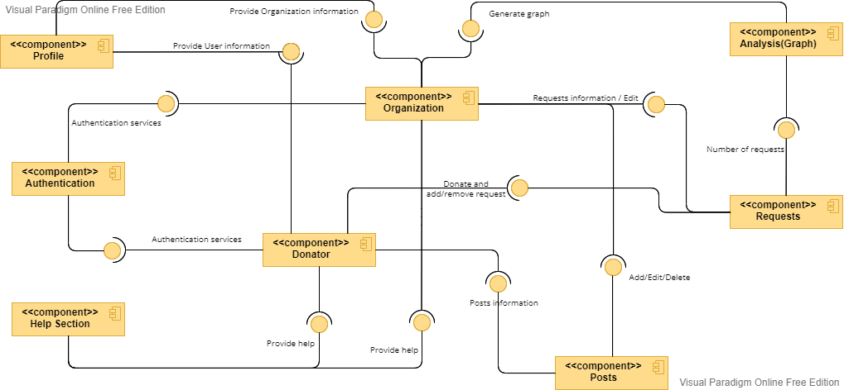
Component Diagram

Slide 24
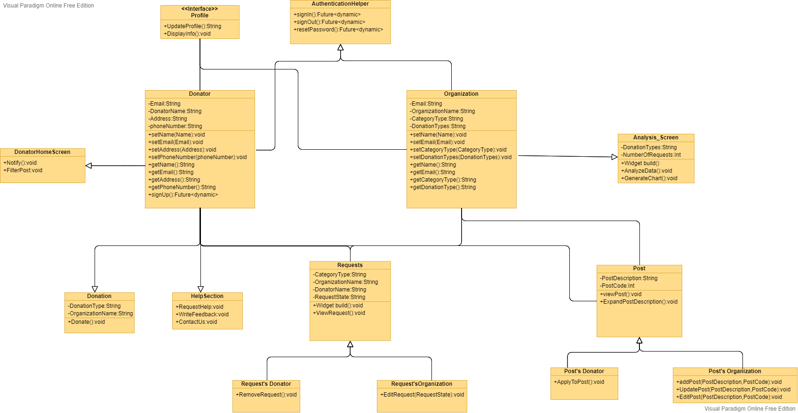
Class Diagram

Slide 25
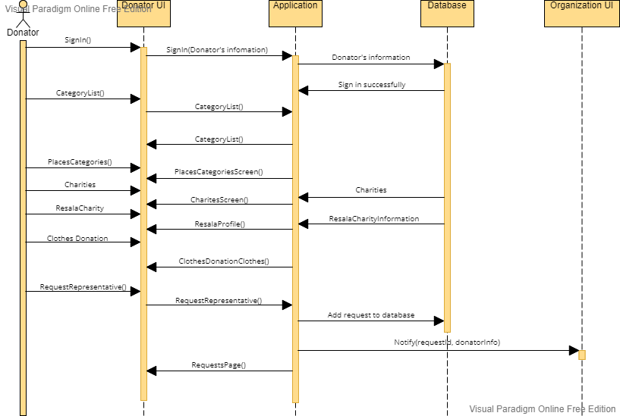
Sequence Diagram 1
Donating scenario:

Slide 26
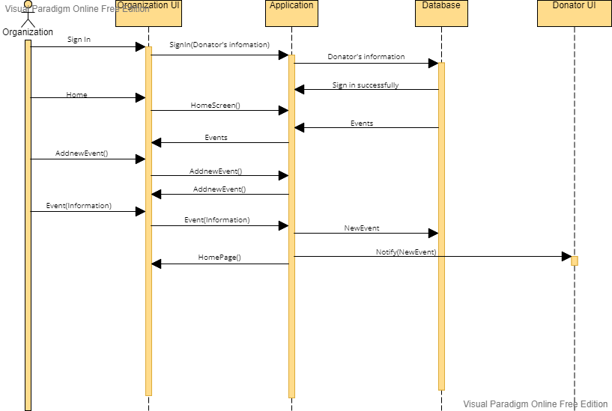
Sequence Diagram 2
Adding new event scenario:

Slide 27
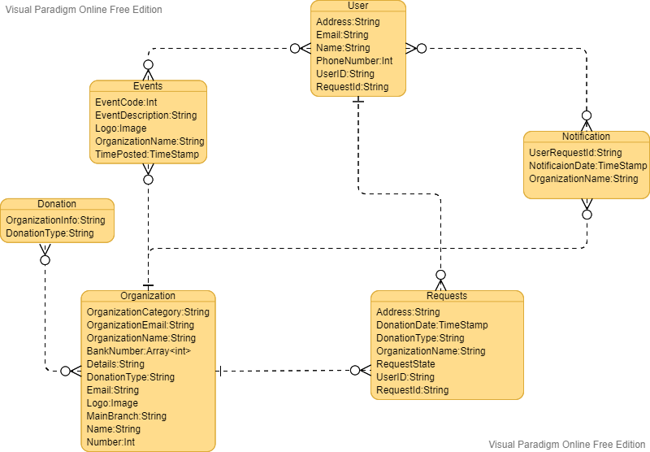
Entity Relationship Diagram (ERD)

Slide 28
TABLE OF CONTENTS
01
02
03
Project idea
Problem significance
Project specifications
Idea description and
domain of interest.
Problems to be solved.
Requirements and important diagrams.
04
05
06
Time Plan
Demo
Conclusion
Tasks to be fulfilled.
Successive screenshots of our application.
Conclusion to what we have said.

Slide 29
04
Time Plan
Tasks to be fulfilled.

Slide 30
Time Plan
Task Title | Start date | End date | Duration
Project definition | 10/1/2021 | 10/8/2021 | 7
Idea brainstorming | 10/22/2021 | 11/1/2021 | 10
Analysis | 11/15/2021 | 12/15/2021 | 30
Requirements | 12/18/2021 | 12/22/2021 | 4
Mid-year documentation | 12/19/2021 | 2/22/2022 | 65
Changes in the documentation | 2/11/2022 | 2/14/2022 | 3
Kher Wallet Logo | 2/14/2022 | 2/20/2022 | 6
UI prototyping screens | 2/15/2022 | 2/20/2022 | 5
Mid-year Presentation | 2/20/2022 | 2/24/2022 | 4
Design and architecture | 2/25/2022 | 7/4/2022 | 129
Flutter implementation | 3/8/2022 | 7/4/2022 | 118
Data gathering | 6/22/2022 | 7/4/2022 | 12
Acceptance | 7/4/2022 | 7/7/2022 | 3
Application Testing | 7/6/2022 | 7/10/2022 | 4
Final documentation | 7/5/2022 | 7/13/2022 | 8
Final Presentation | 7/9/2022 | 7/12/2022 | 3
Poster | 7/10/2022 | 7/13/2022 | 3

Slide 31
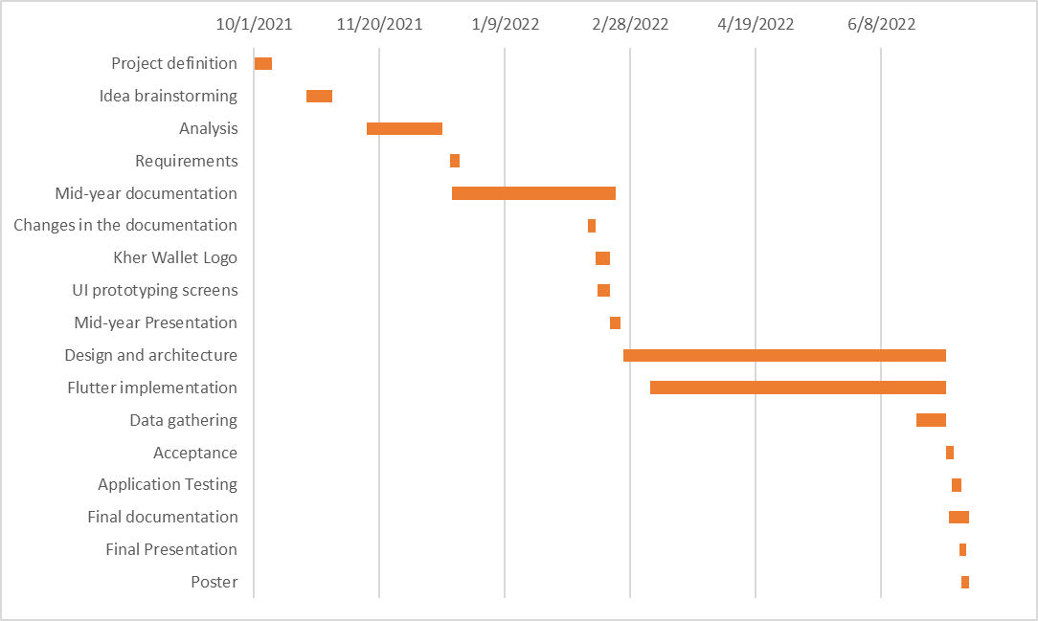
Gantt Chart

Slide 32
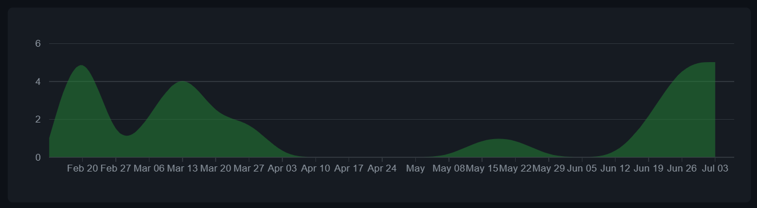
Git hub repository graph

Slide 33
TABLE OF CONTENTS
01
02
03
Project idea
Problem significance
Project specifications
Idea description and
domain of interest.
Problems to be solved.
Requirements and important diagrams.
04
05
06
Time Plan
Demo
Conclusion
Tasks to be fulfilled.
Successive screenshots of our application.
Conclusion to what we have said.

Slide 34
05
Demo
Successive screenshots of our application.

Slide 35
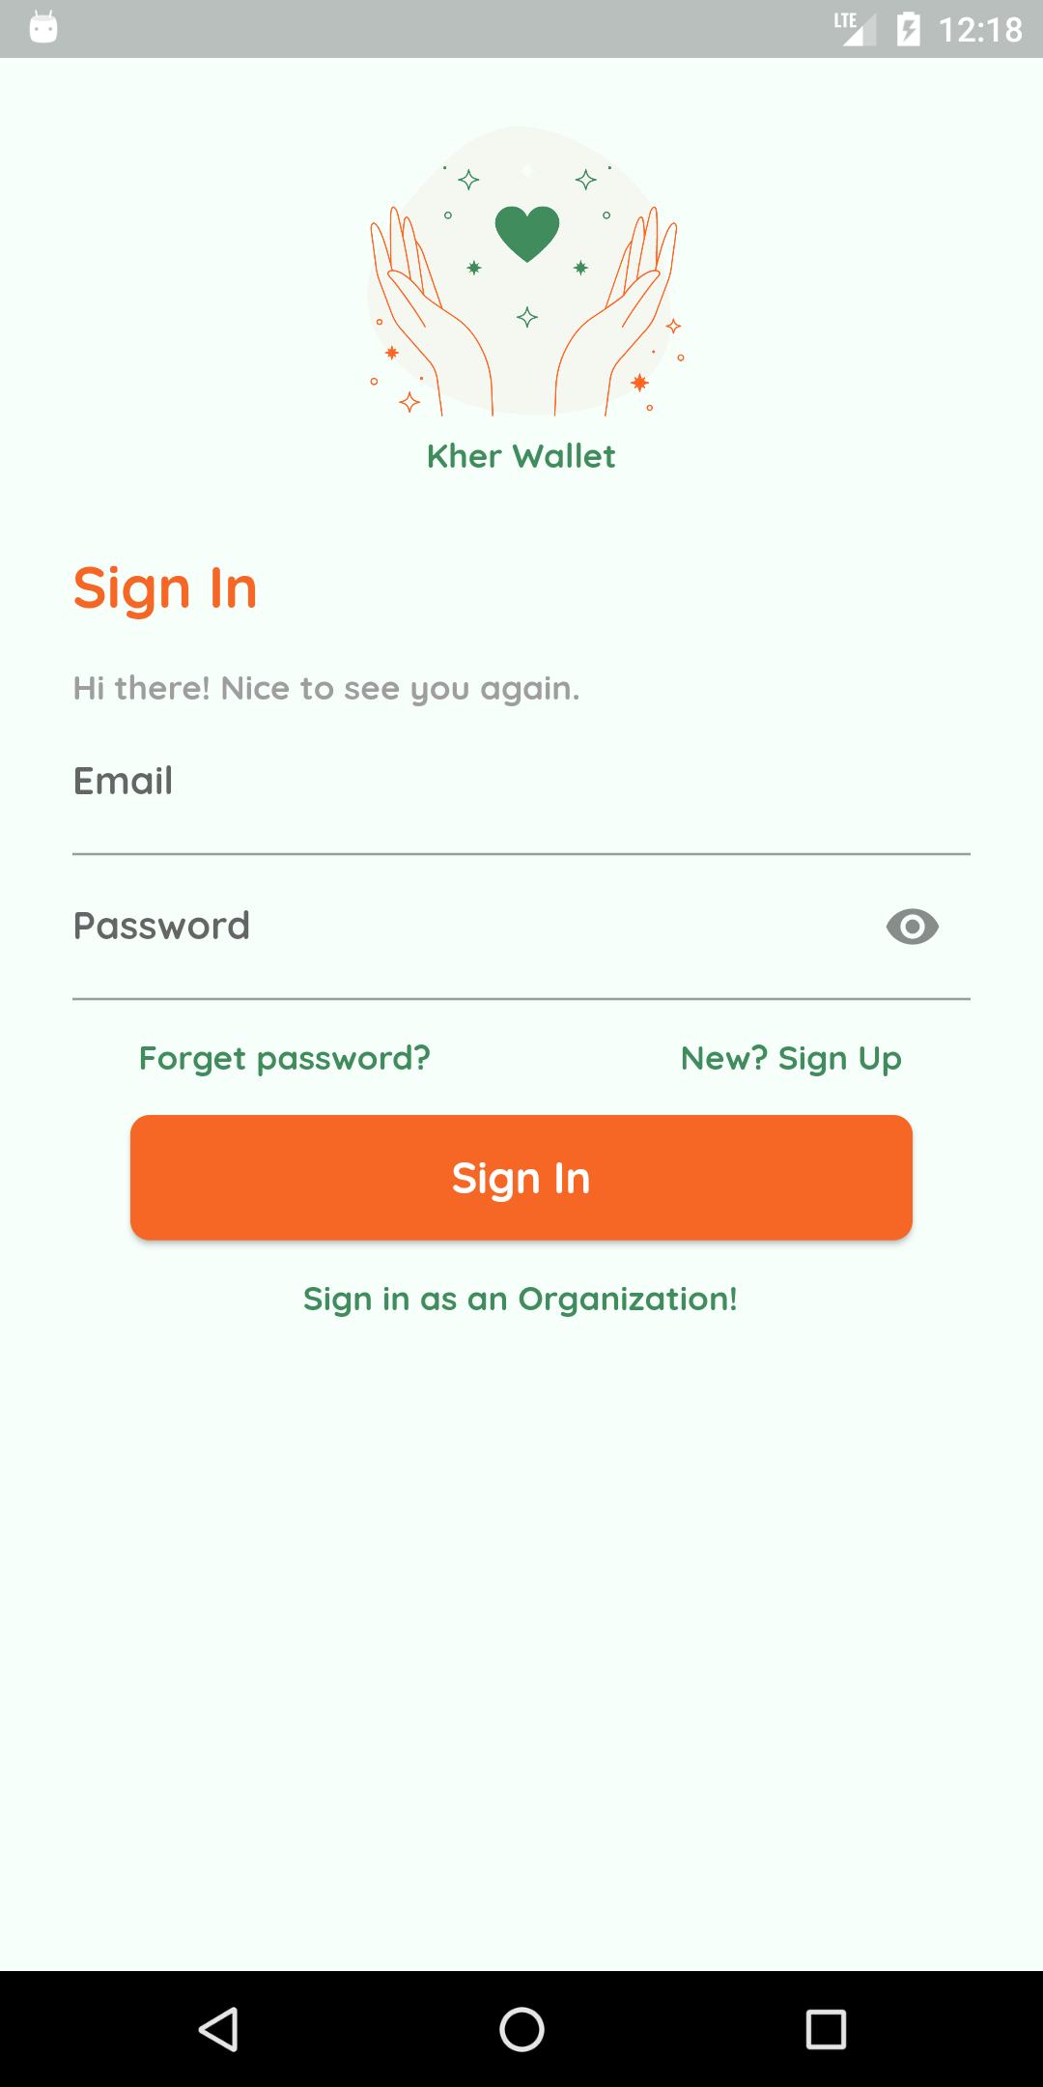
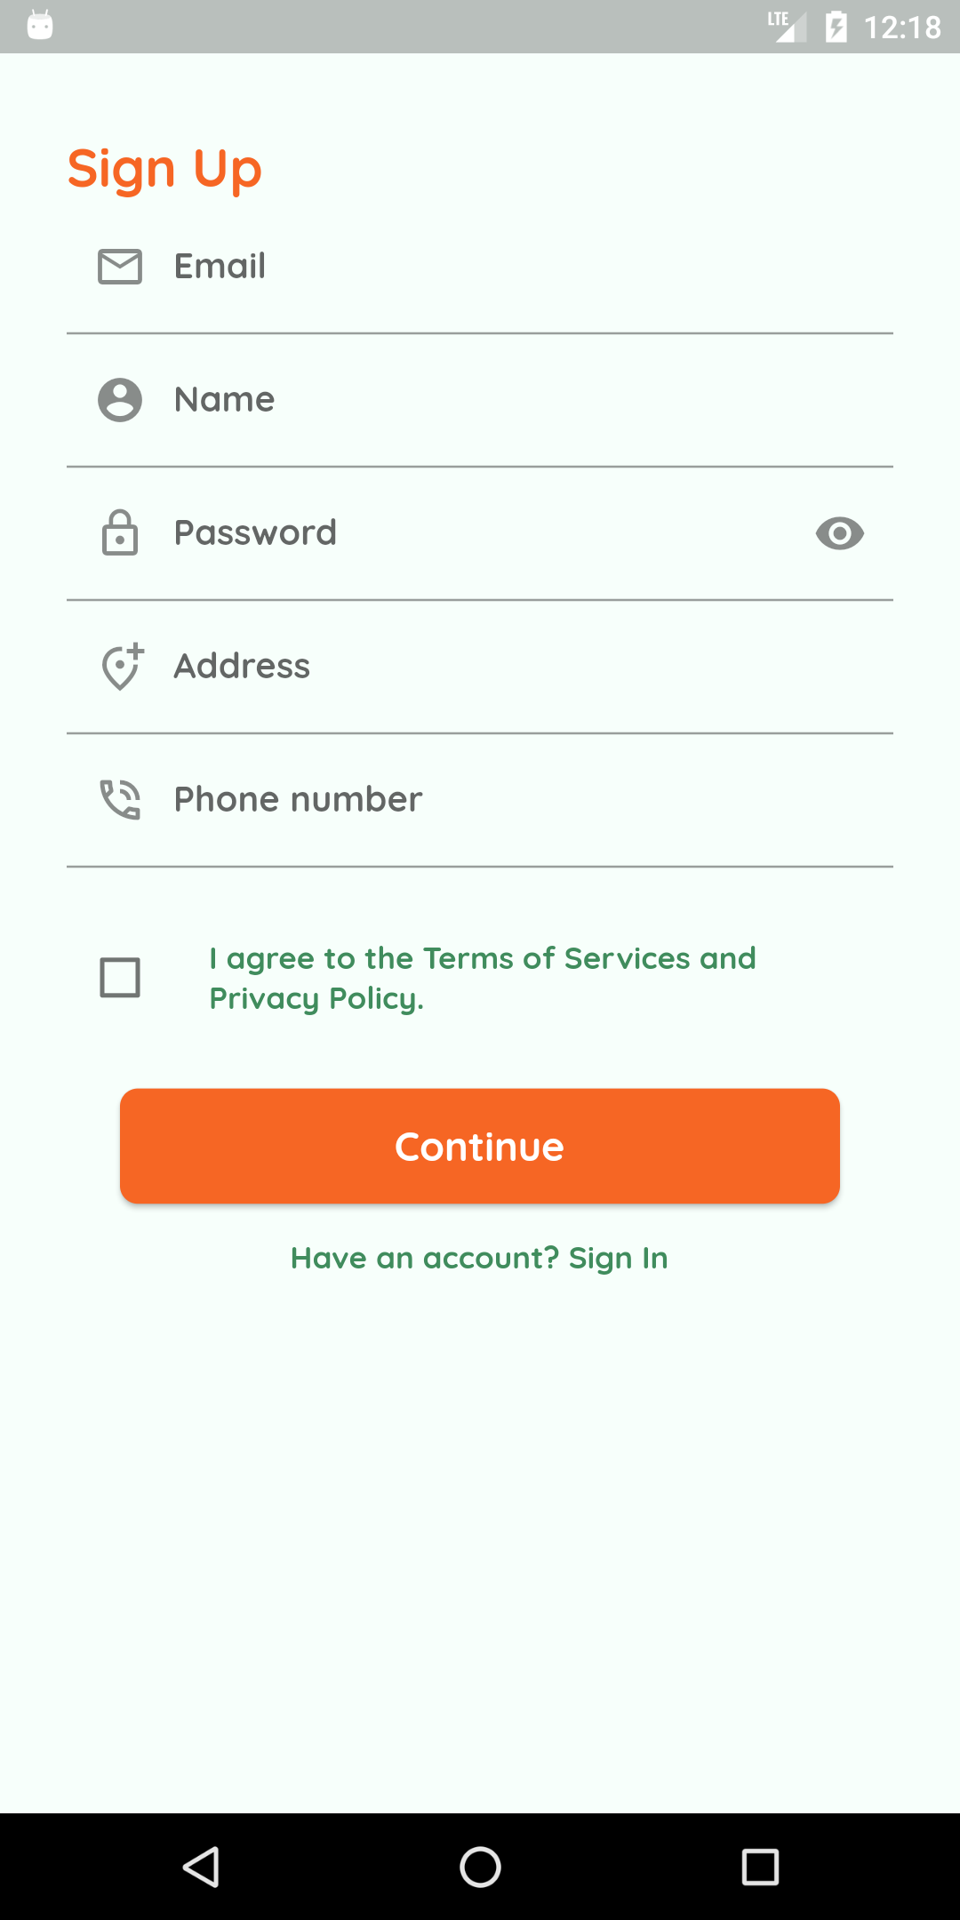
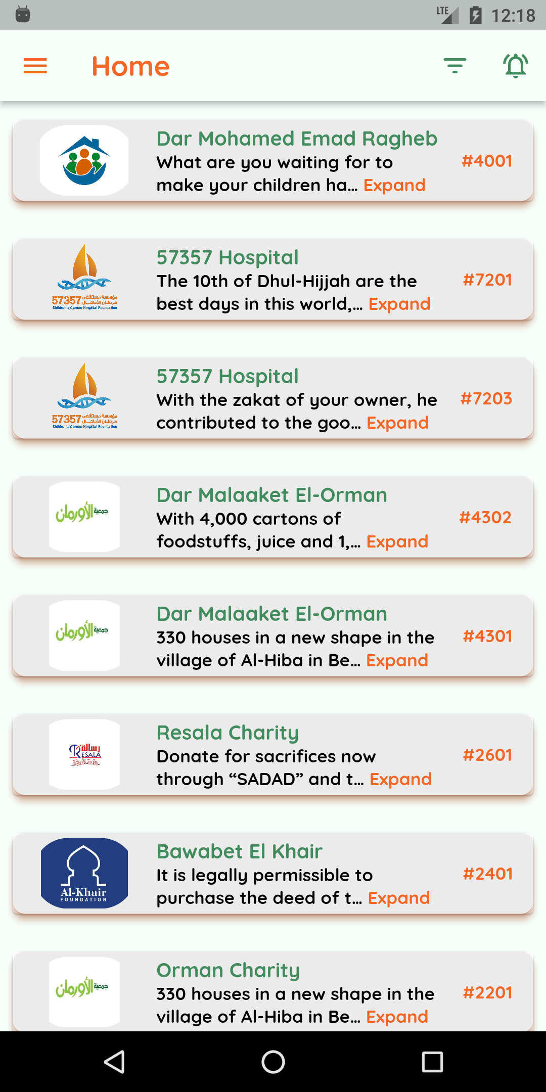
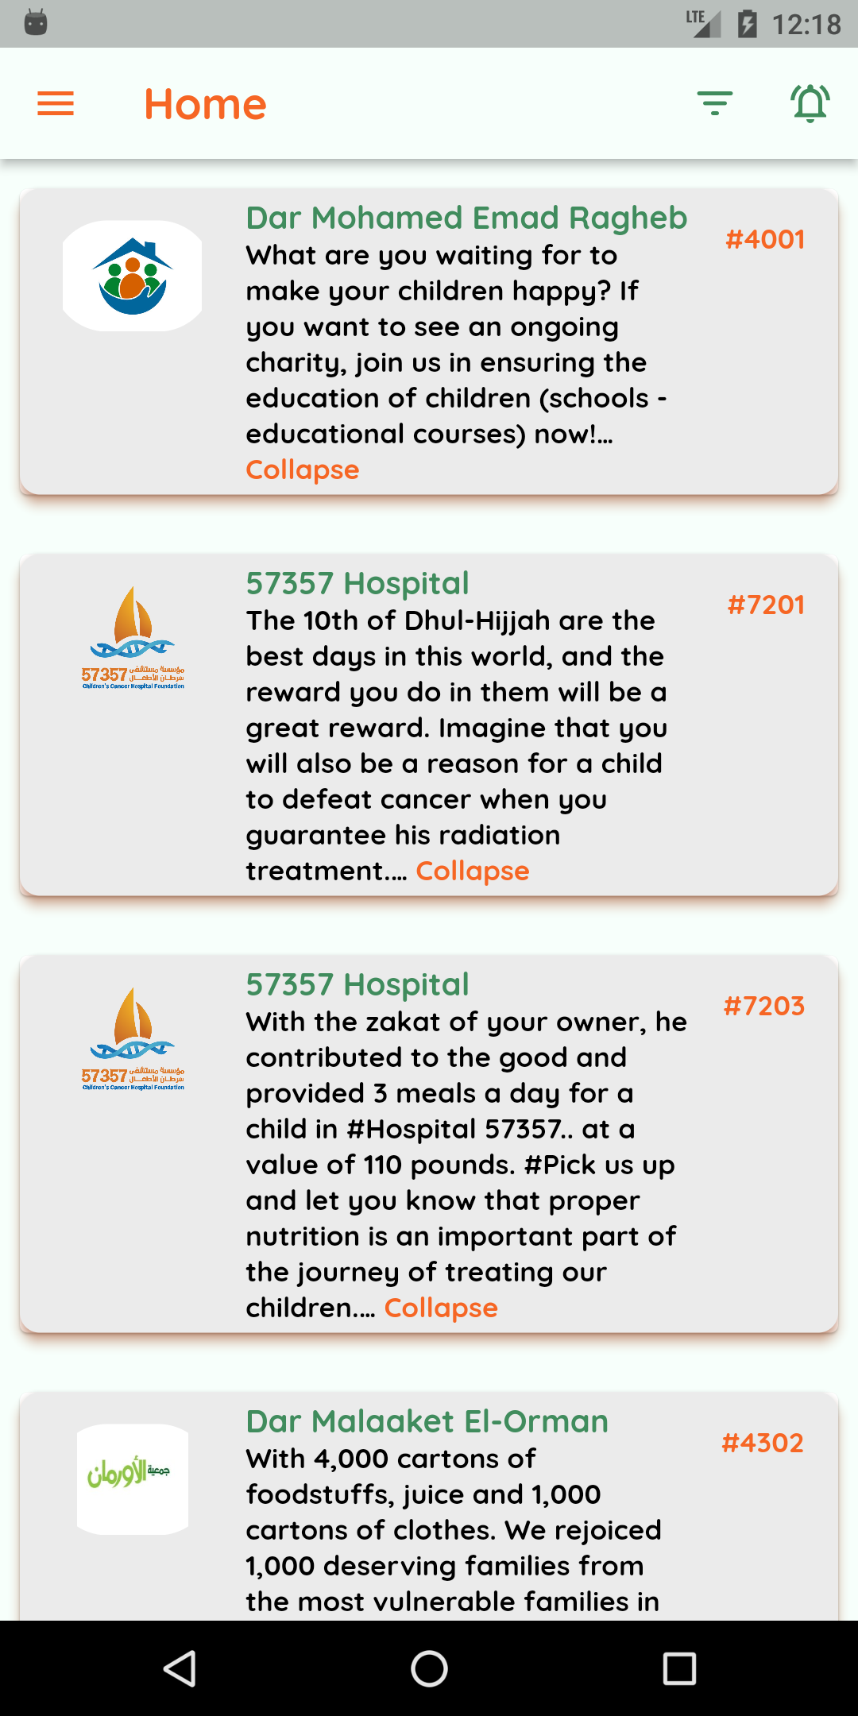
Donator’s demo

Slide 36
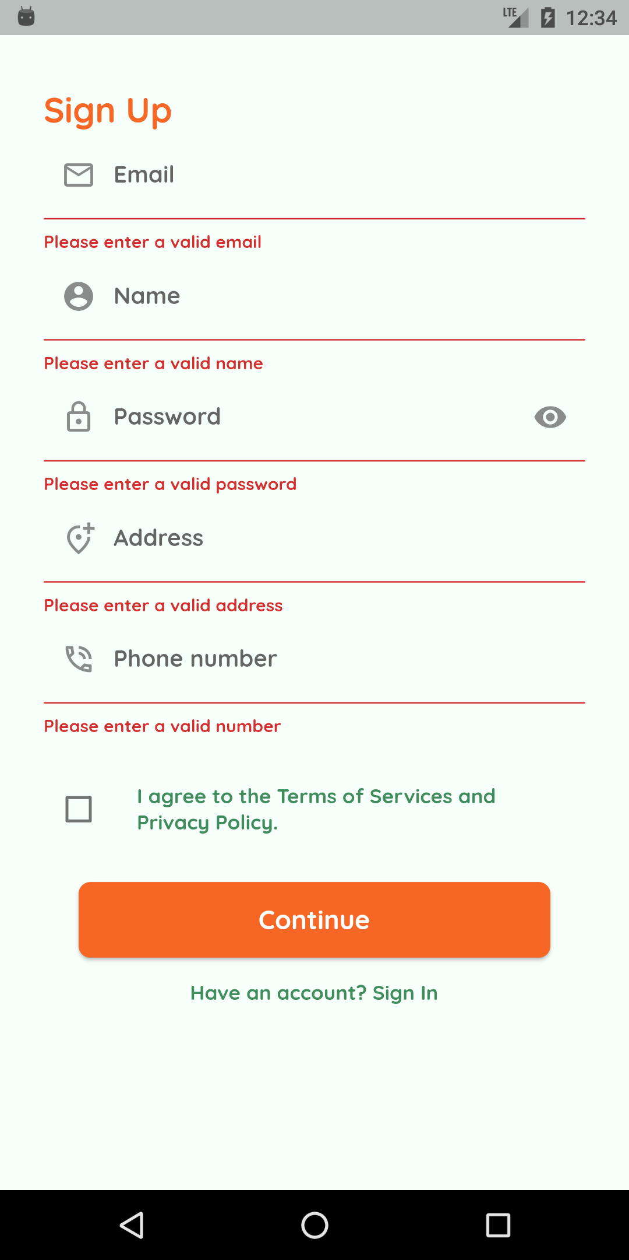
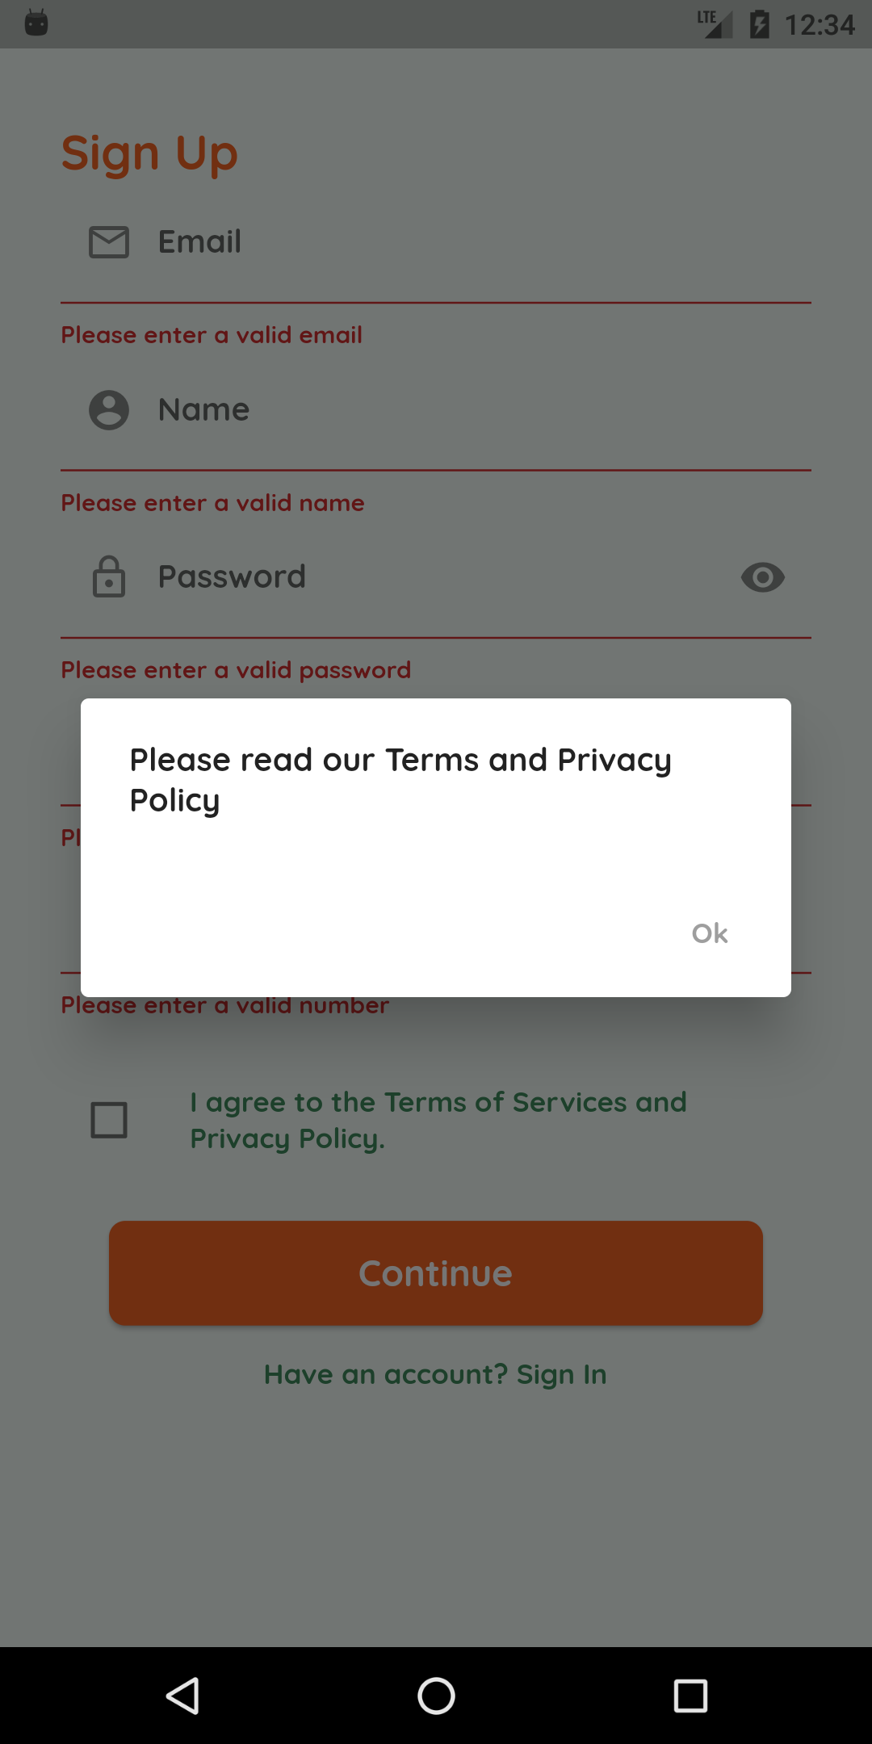
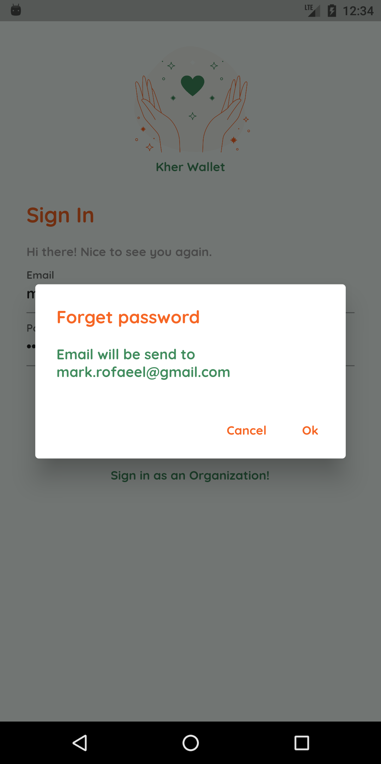
Donator’s demo

Slide 37
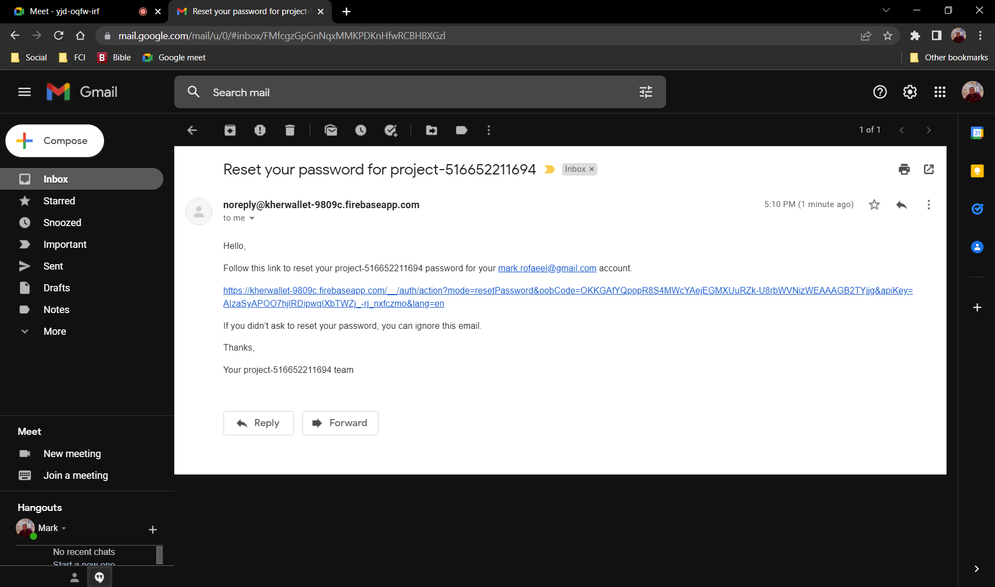
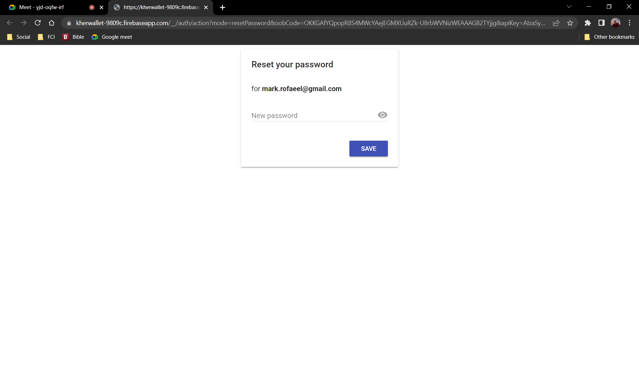
Donator’s demo

Slide 38
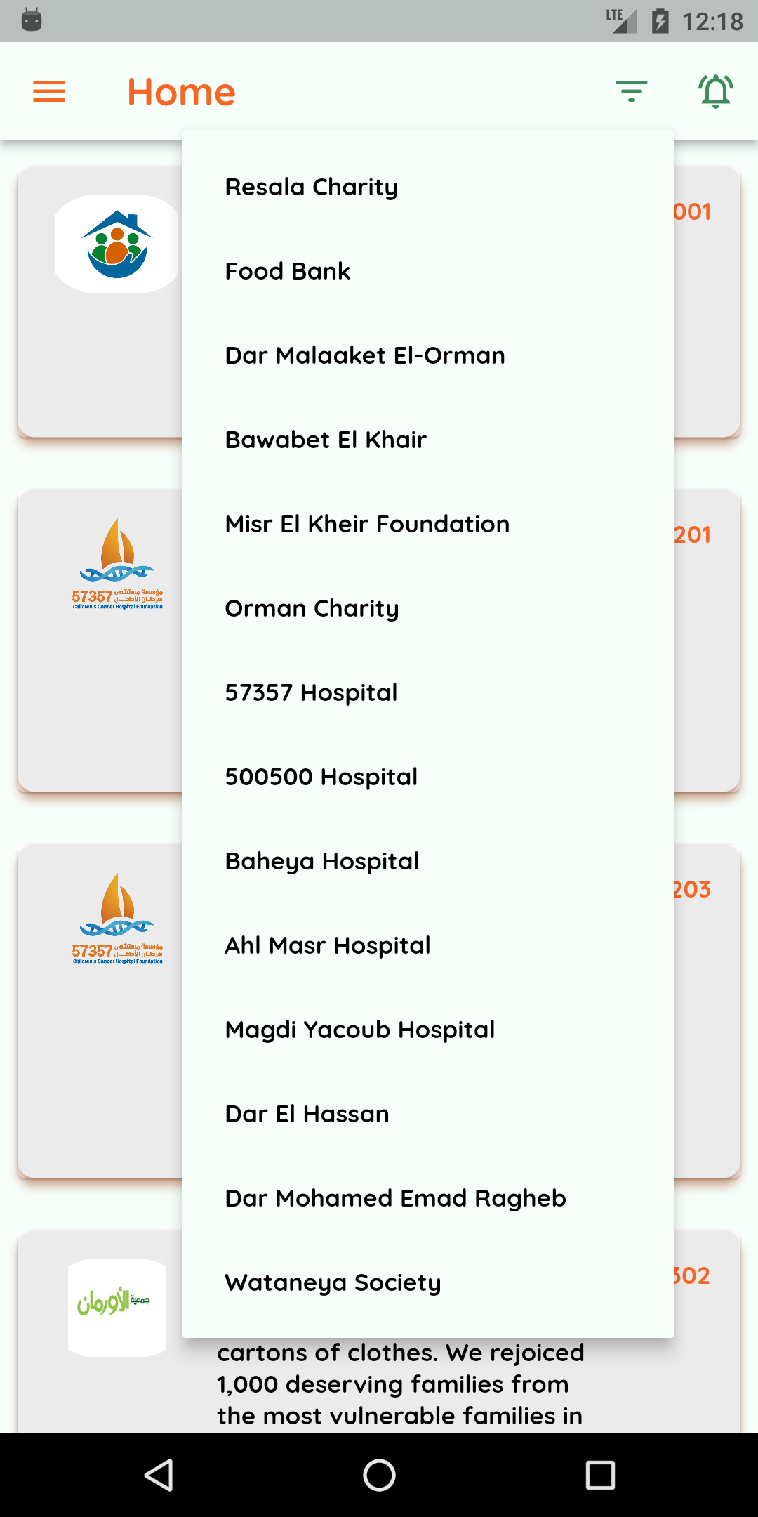
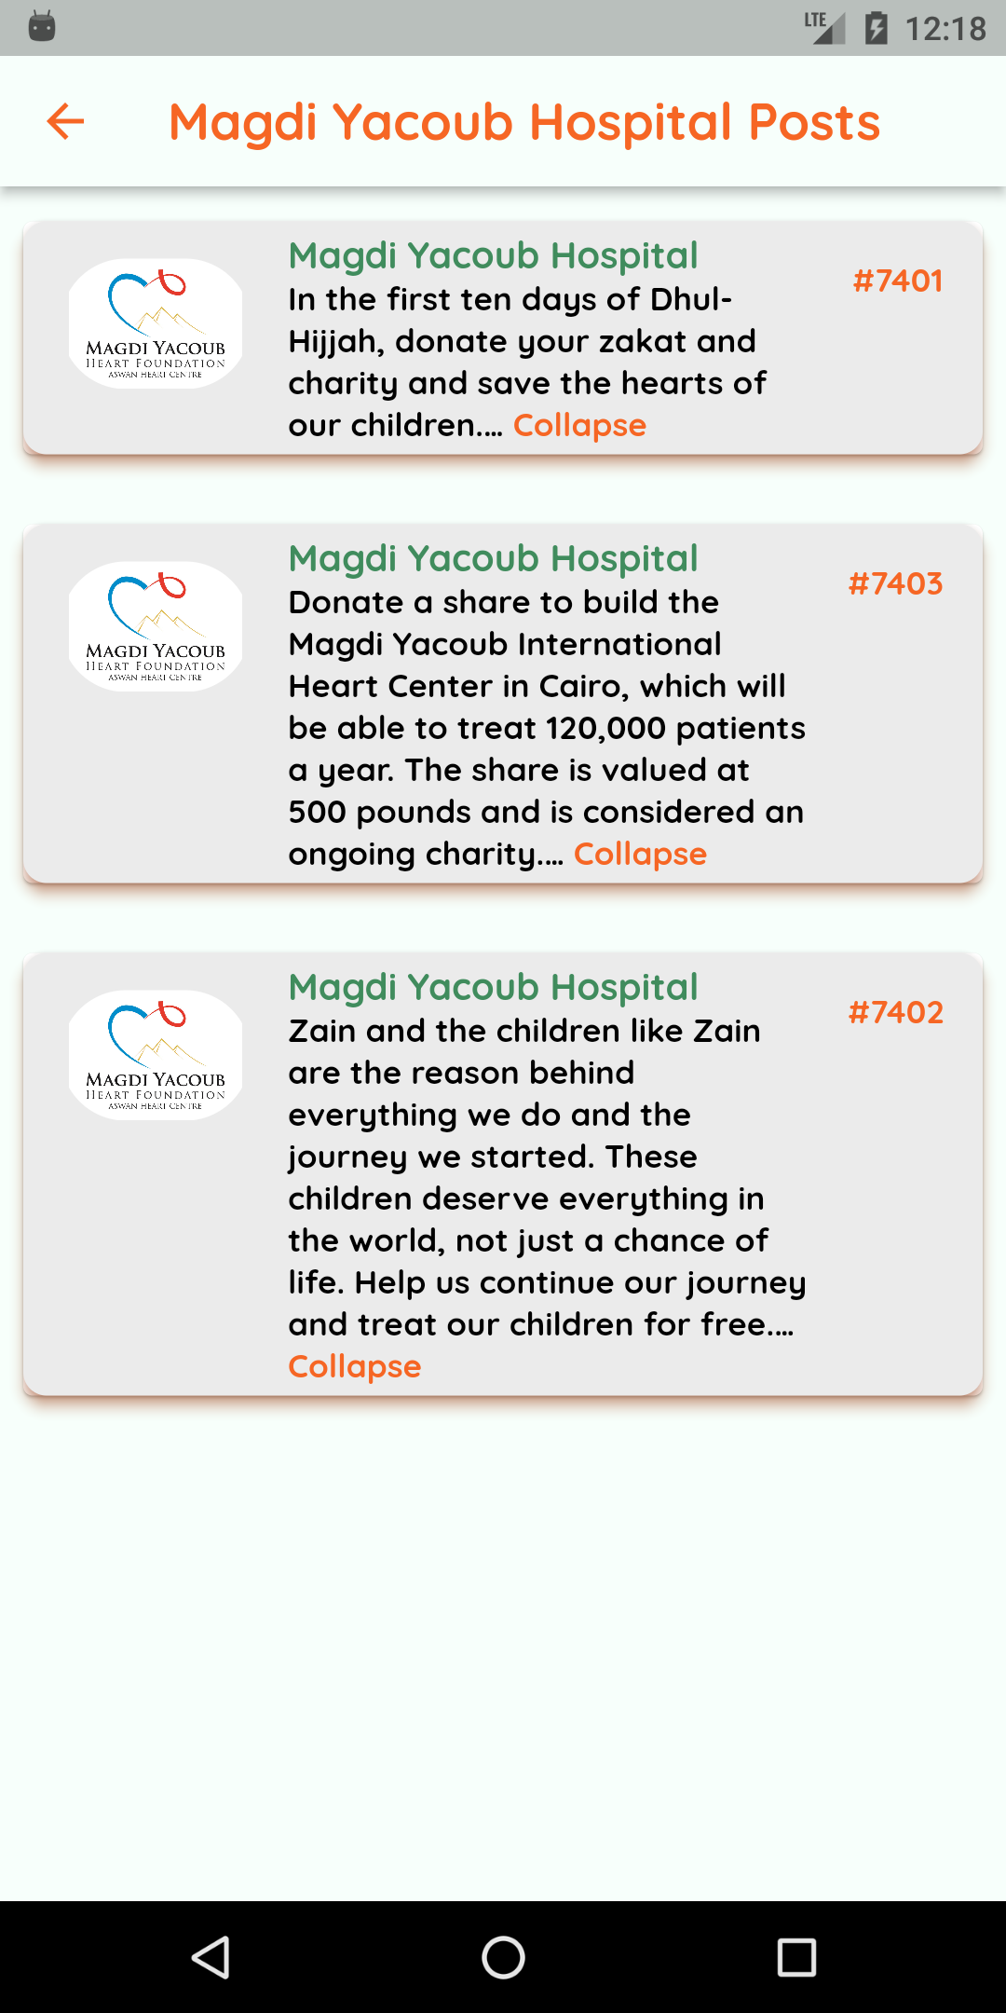
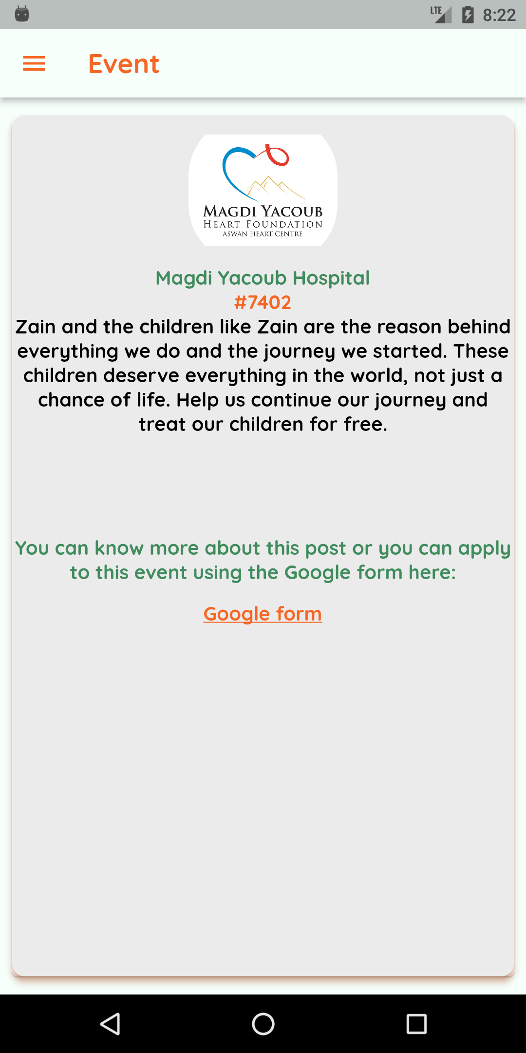
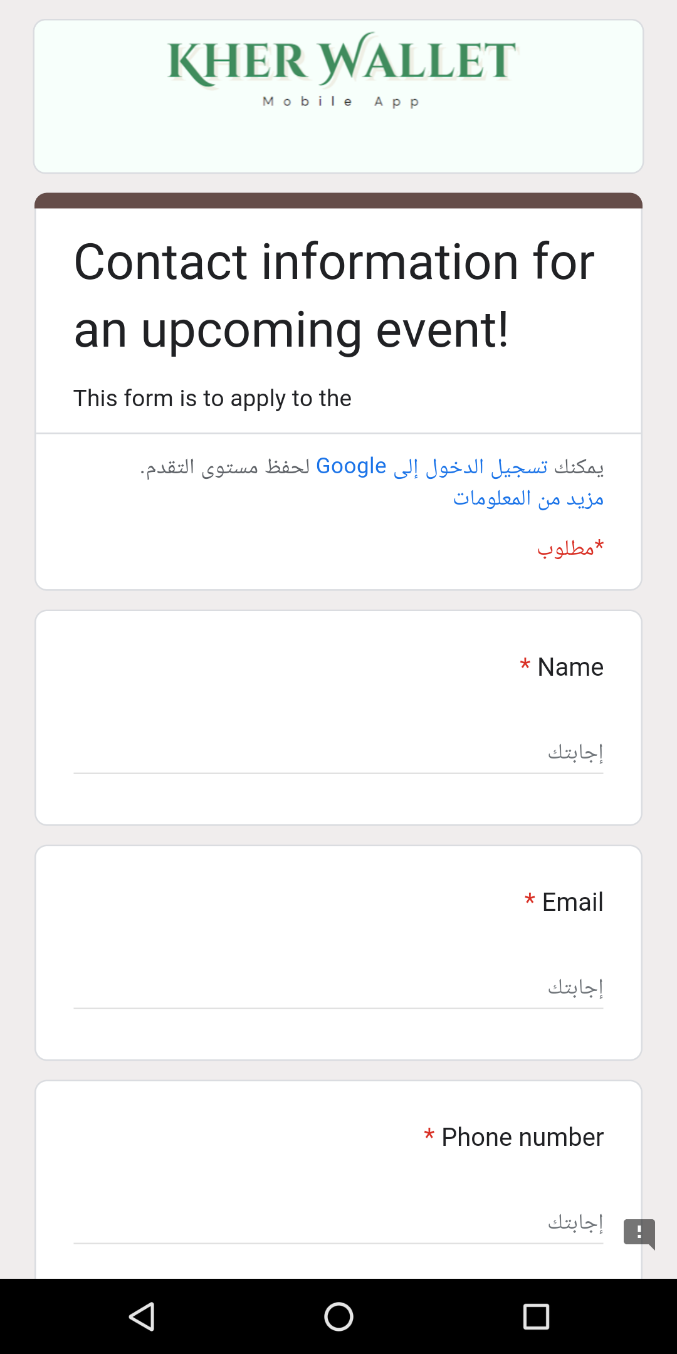
Donator’s demo

Slide 39
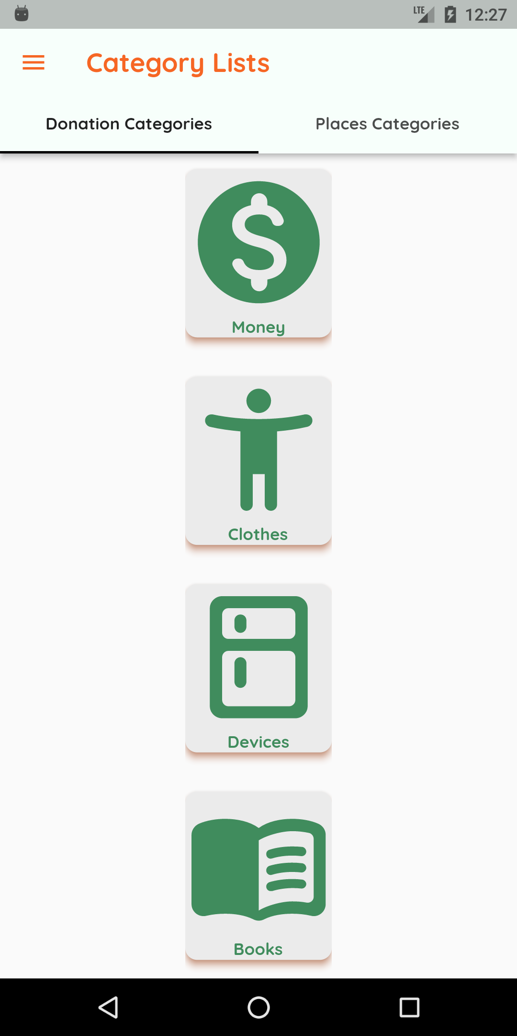
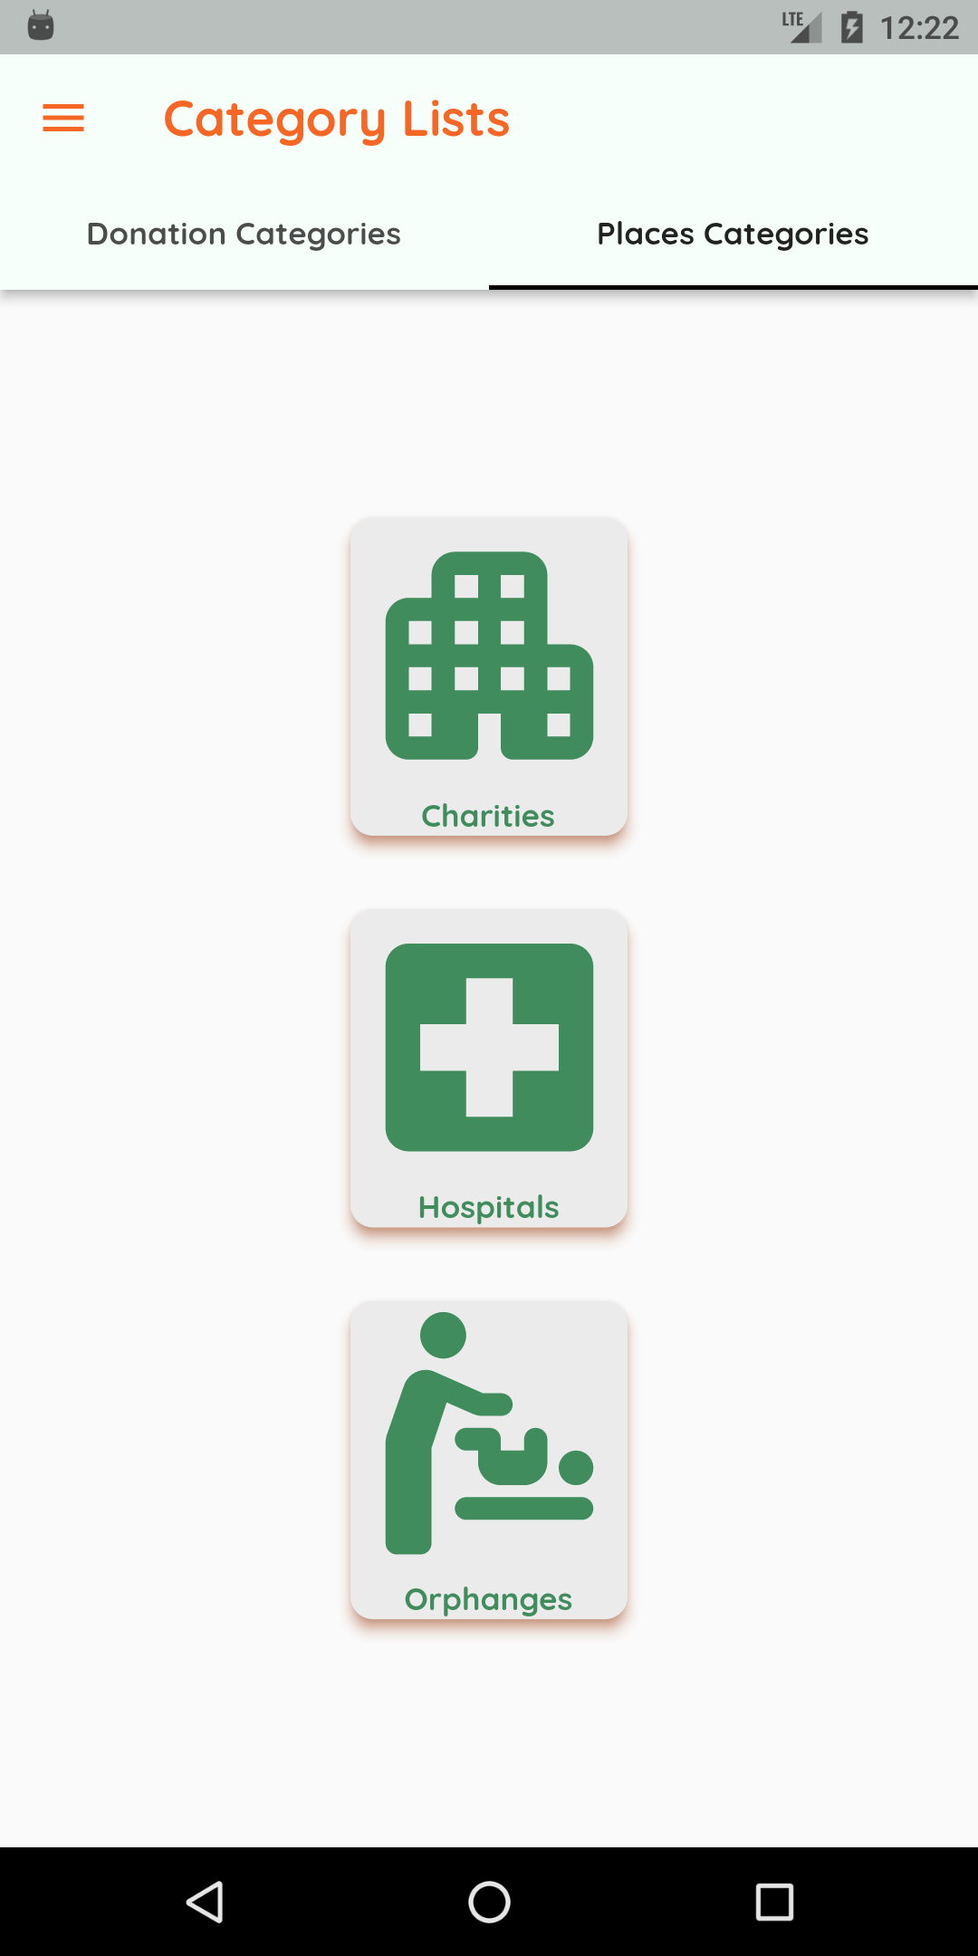
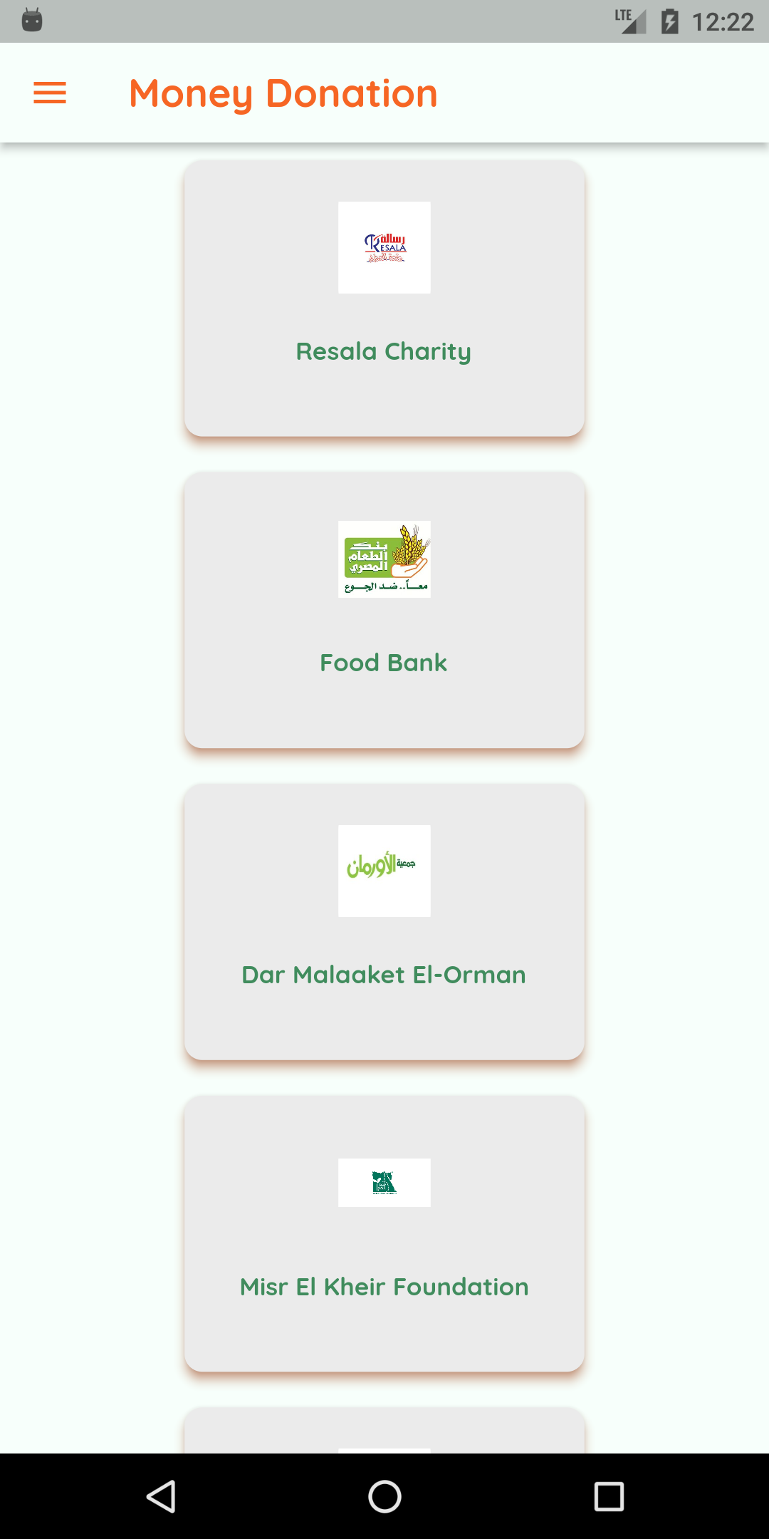
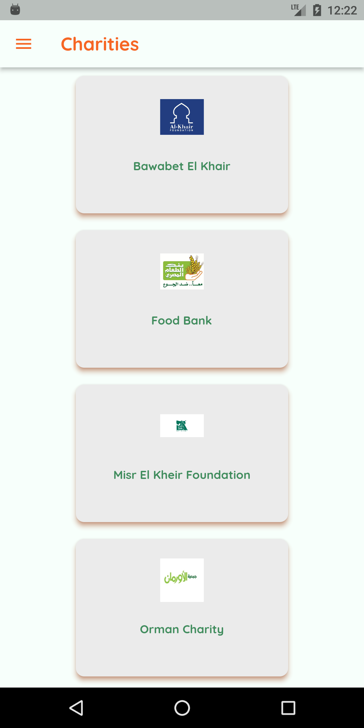
Donator’s demo

Slide 40
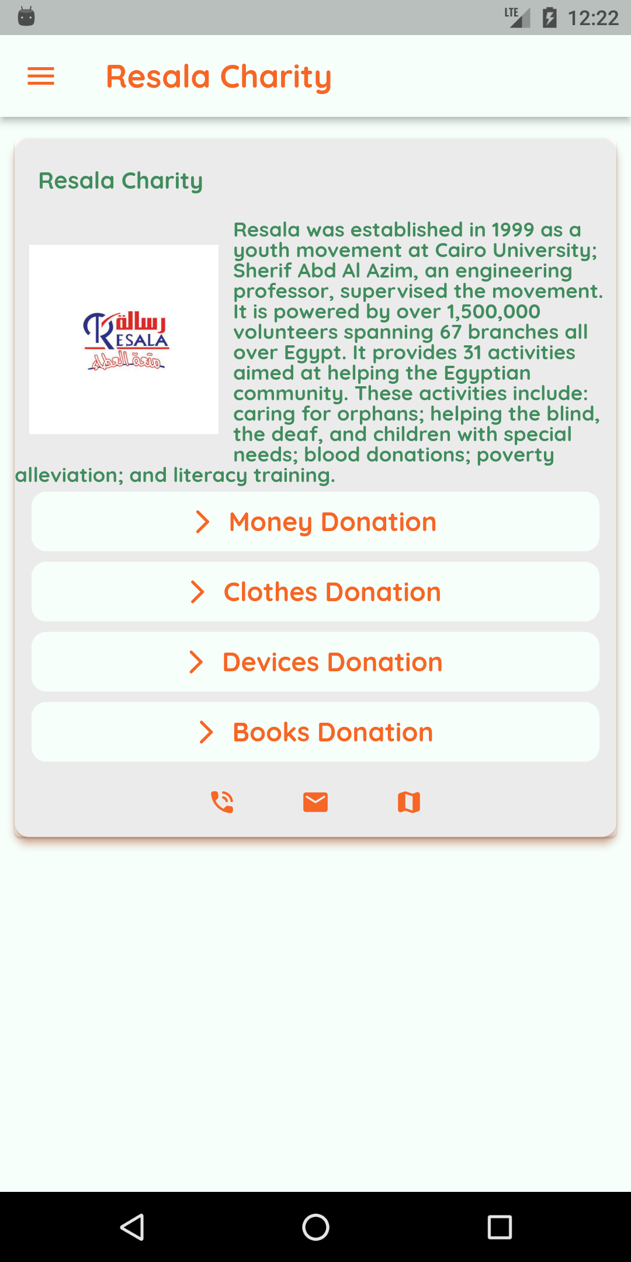
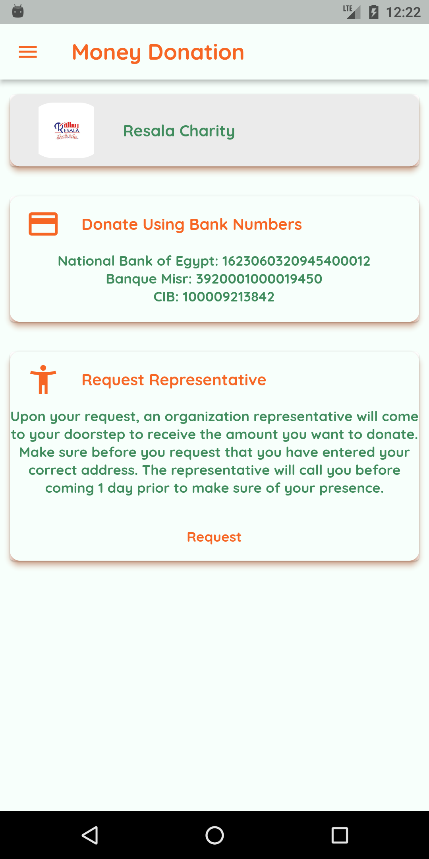
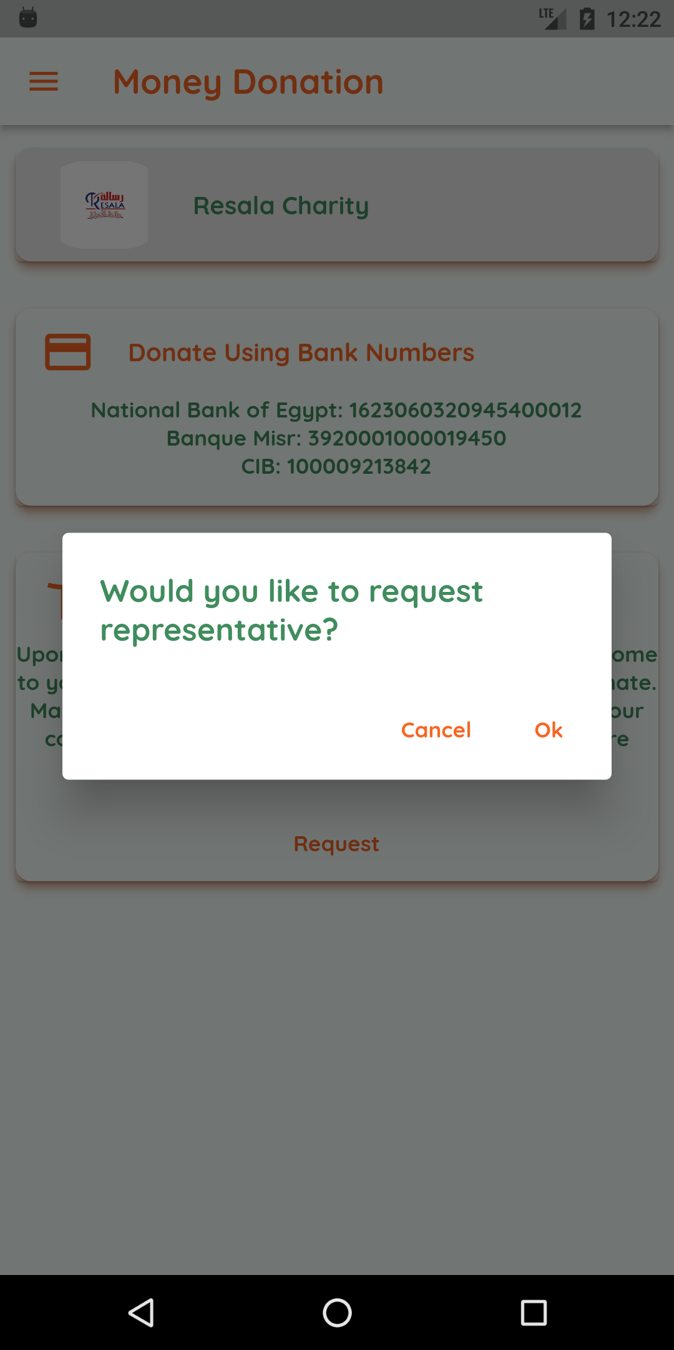
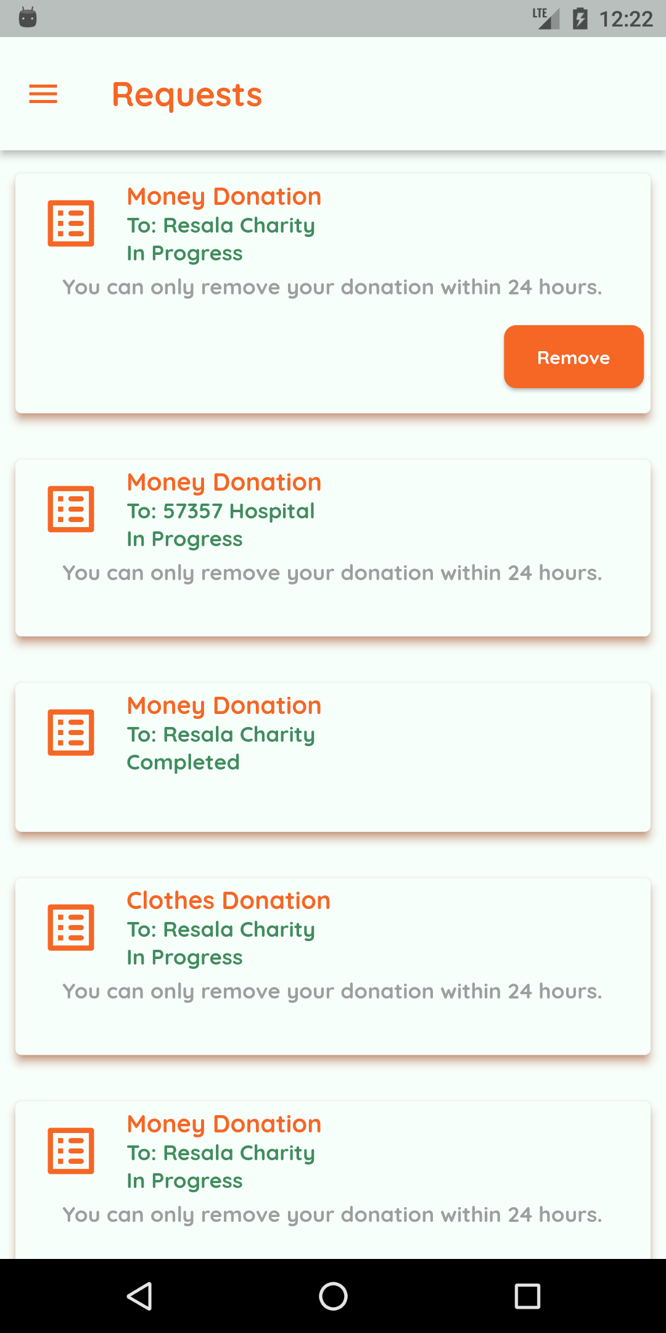
Donator’s demo

Slide 41
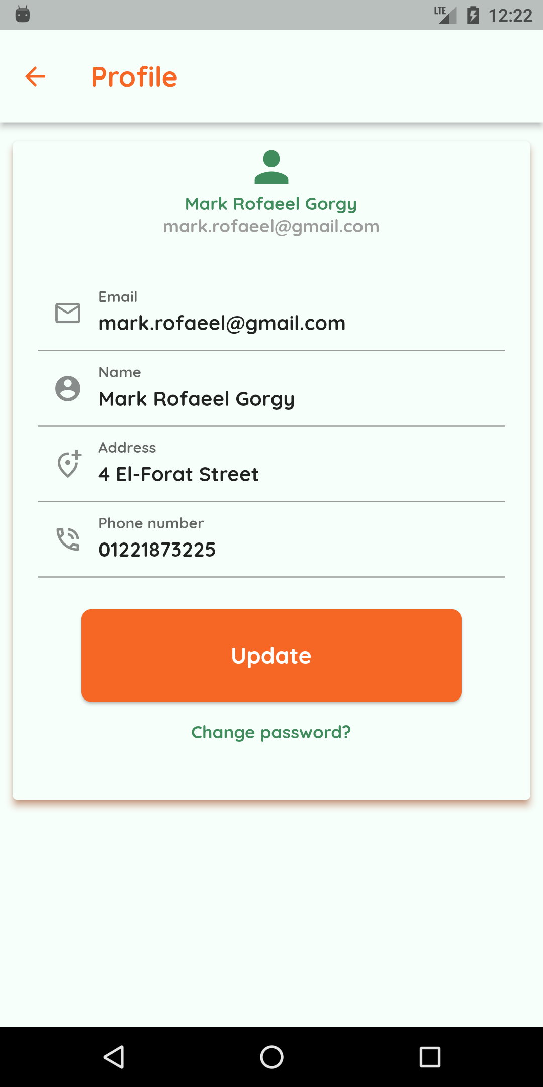
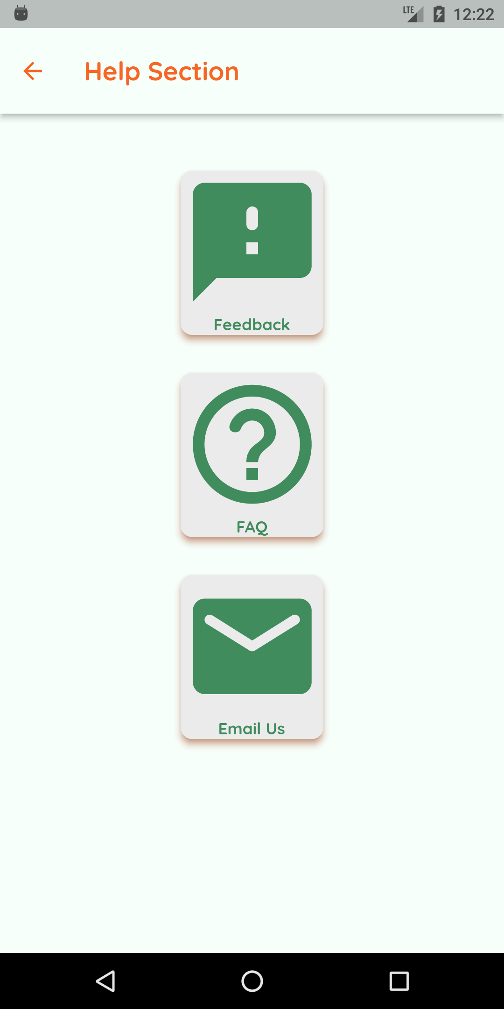
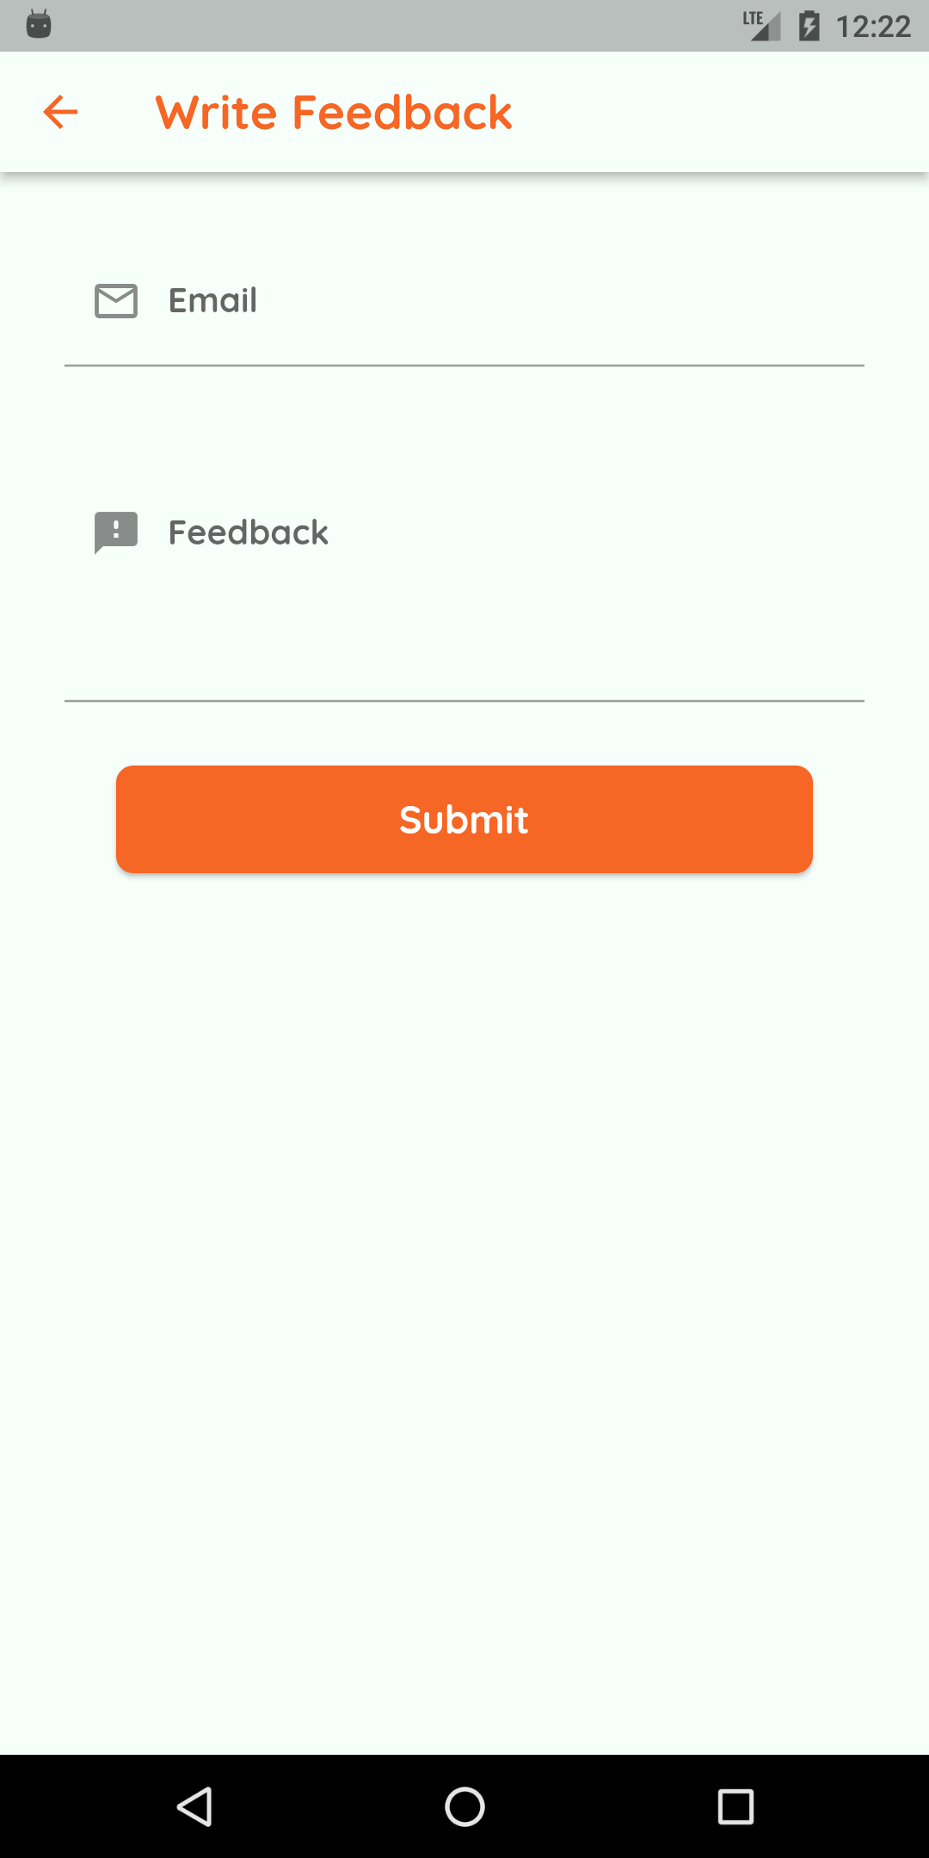
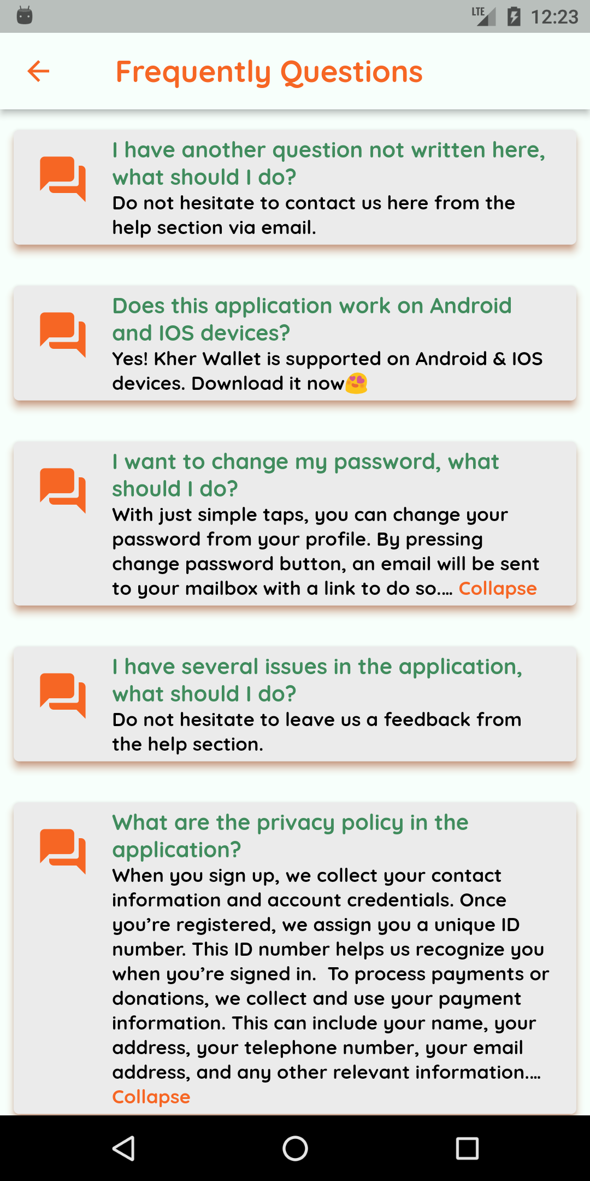
Donator’s demo

Slide 42
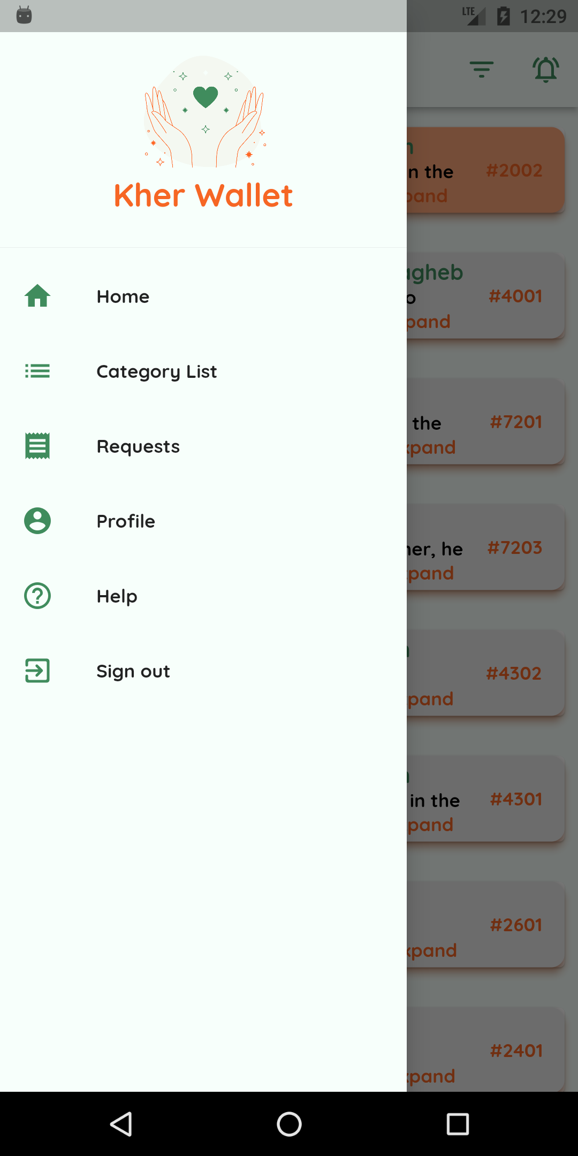
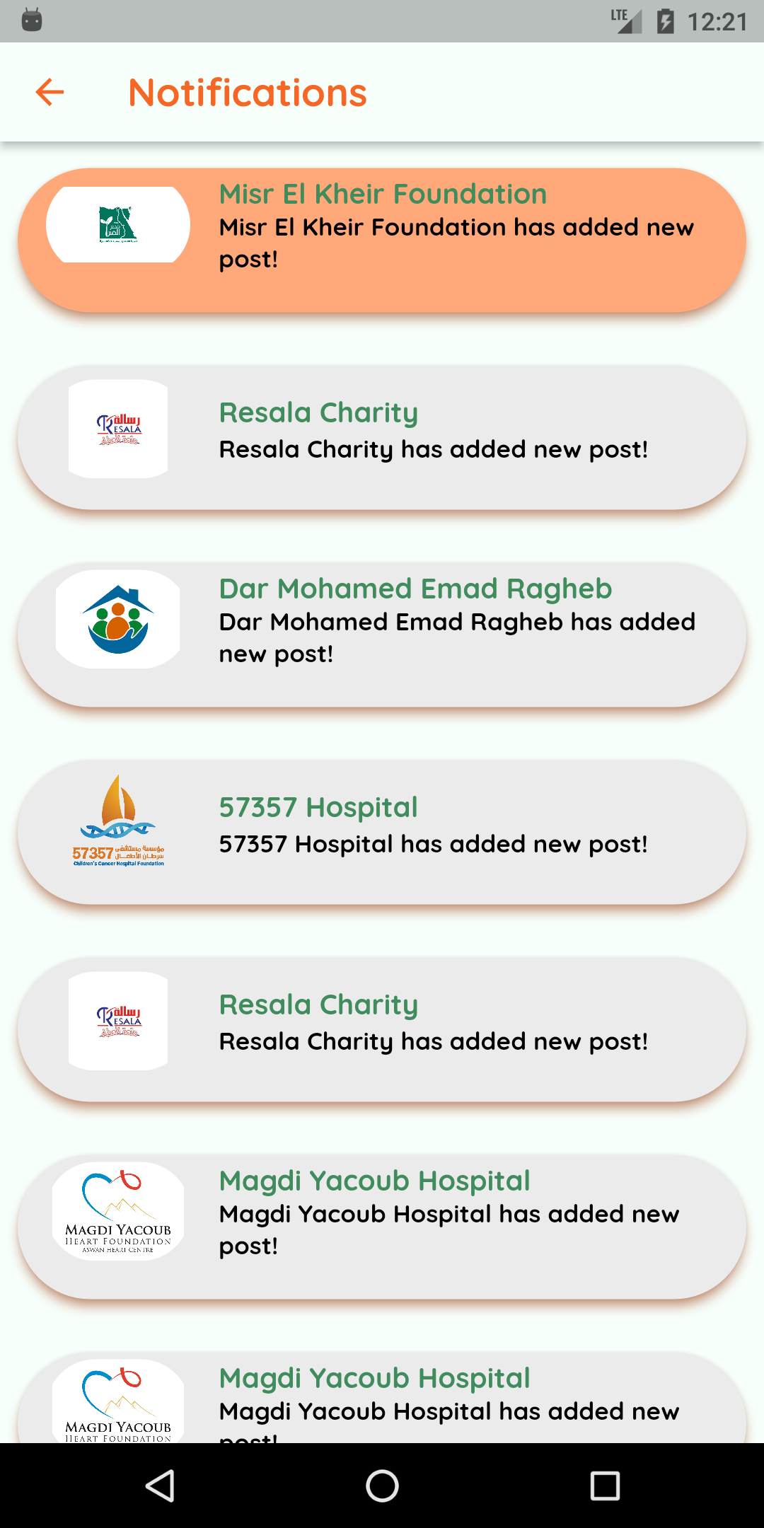
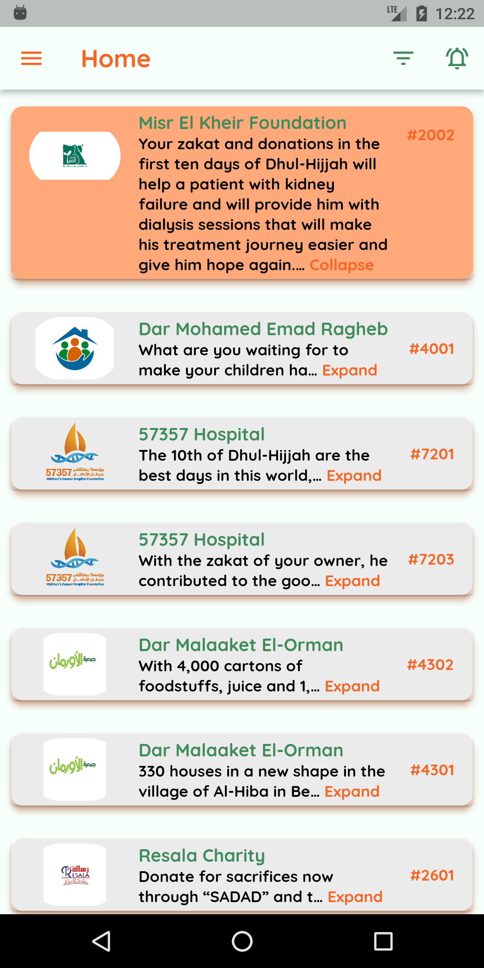
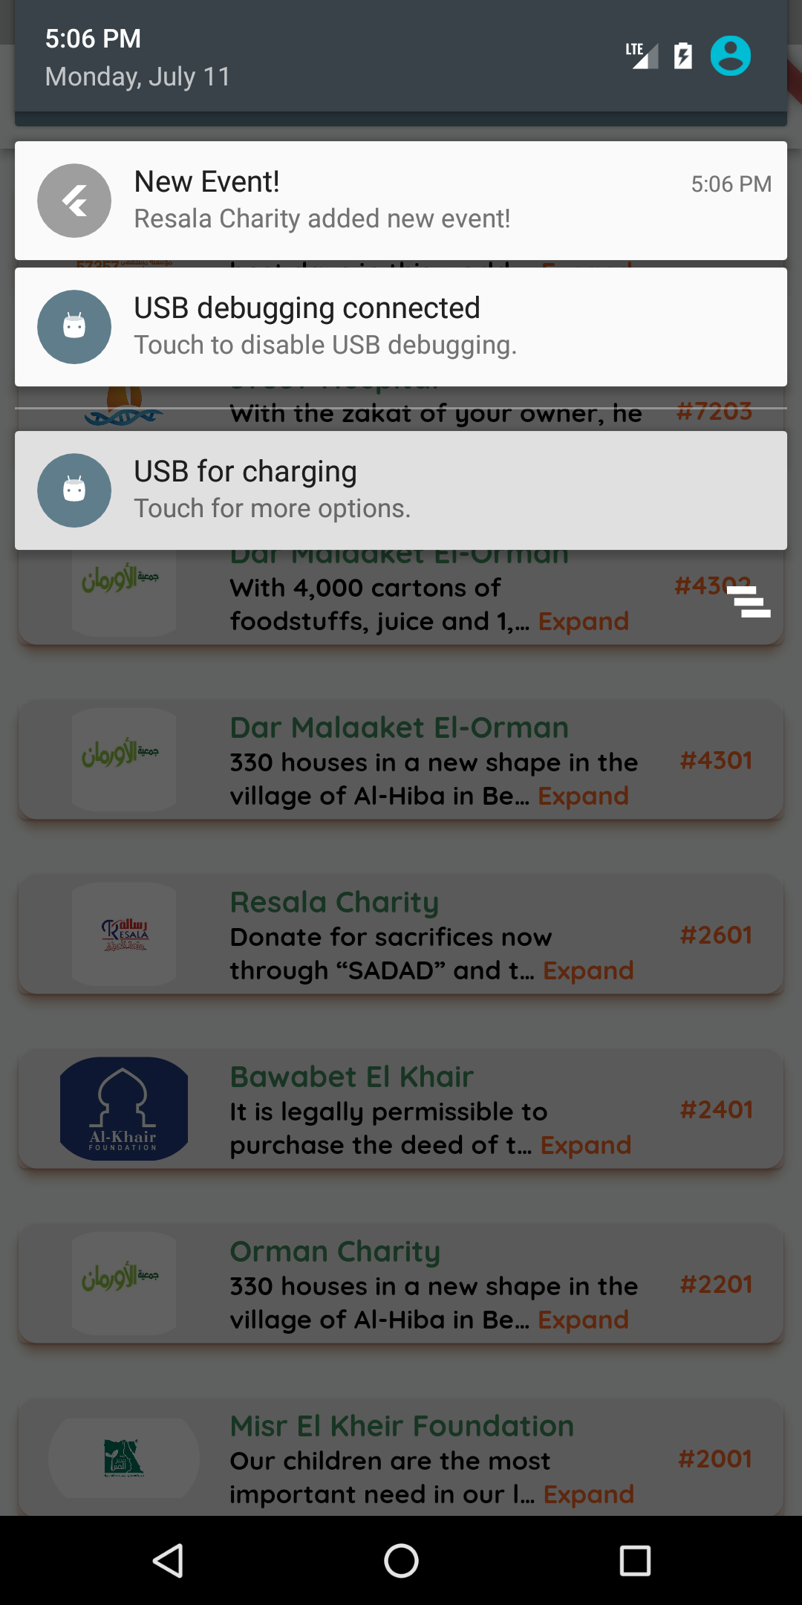
Donator’s demo

Slide 43
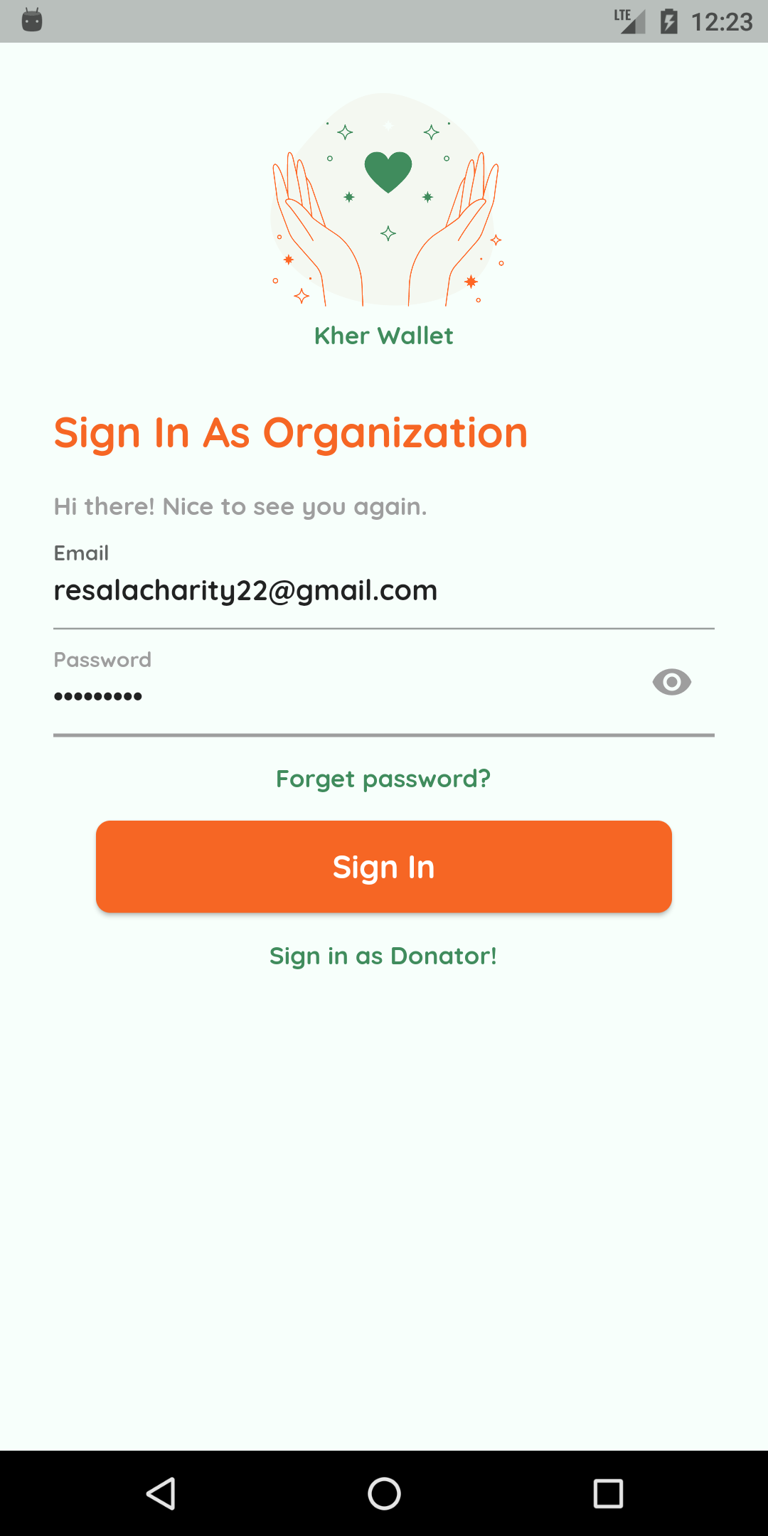
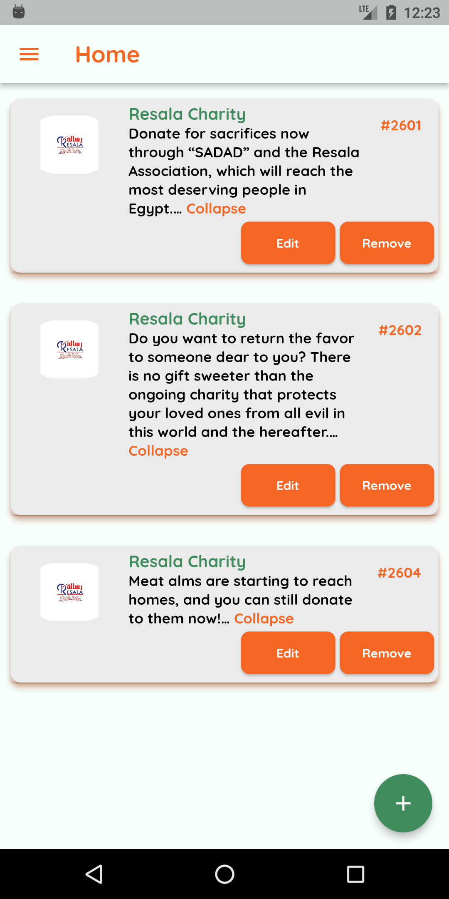
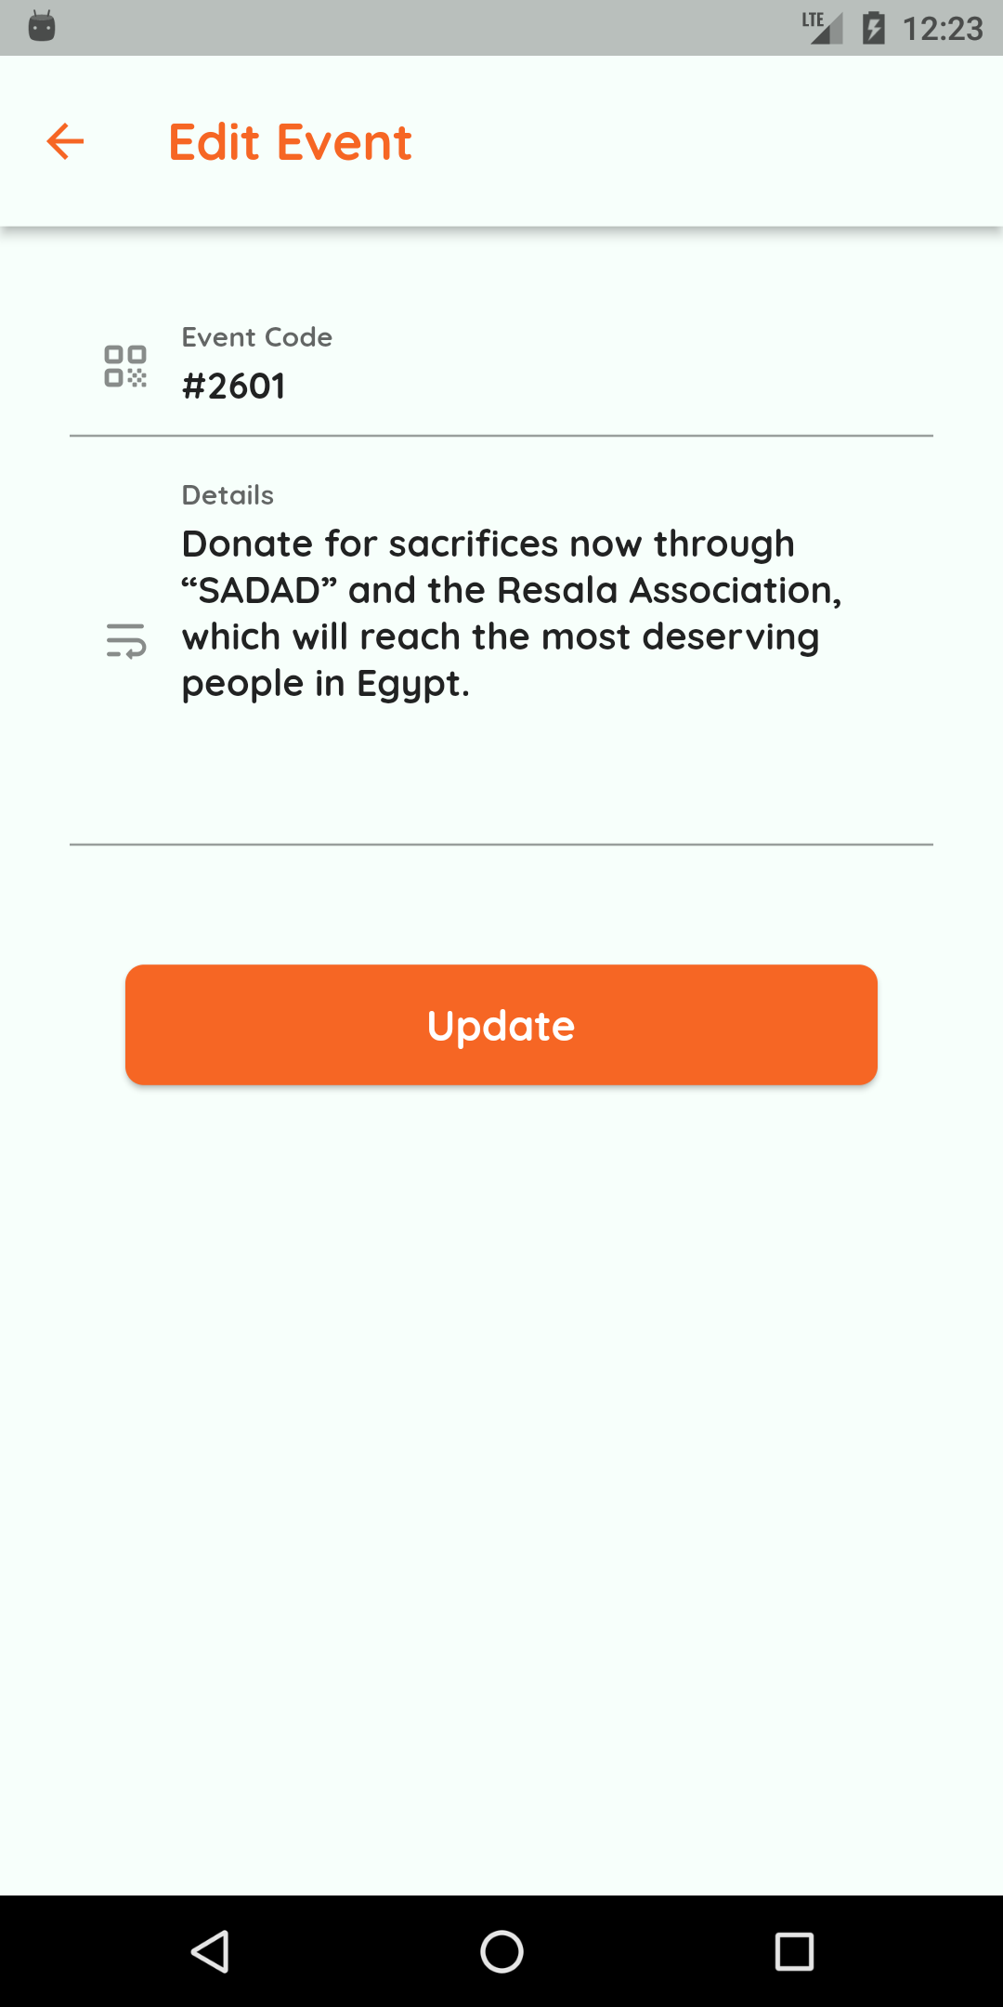
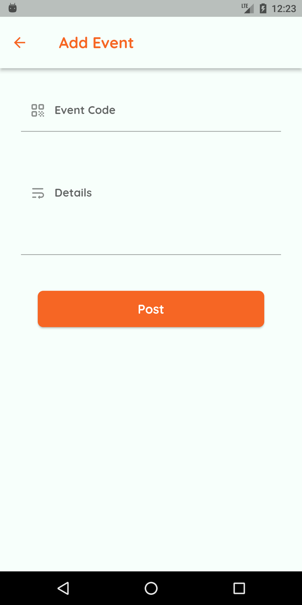
Organization’s demo

Slide 44
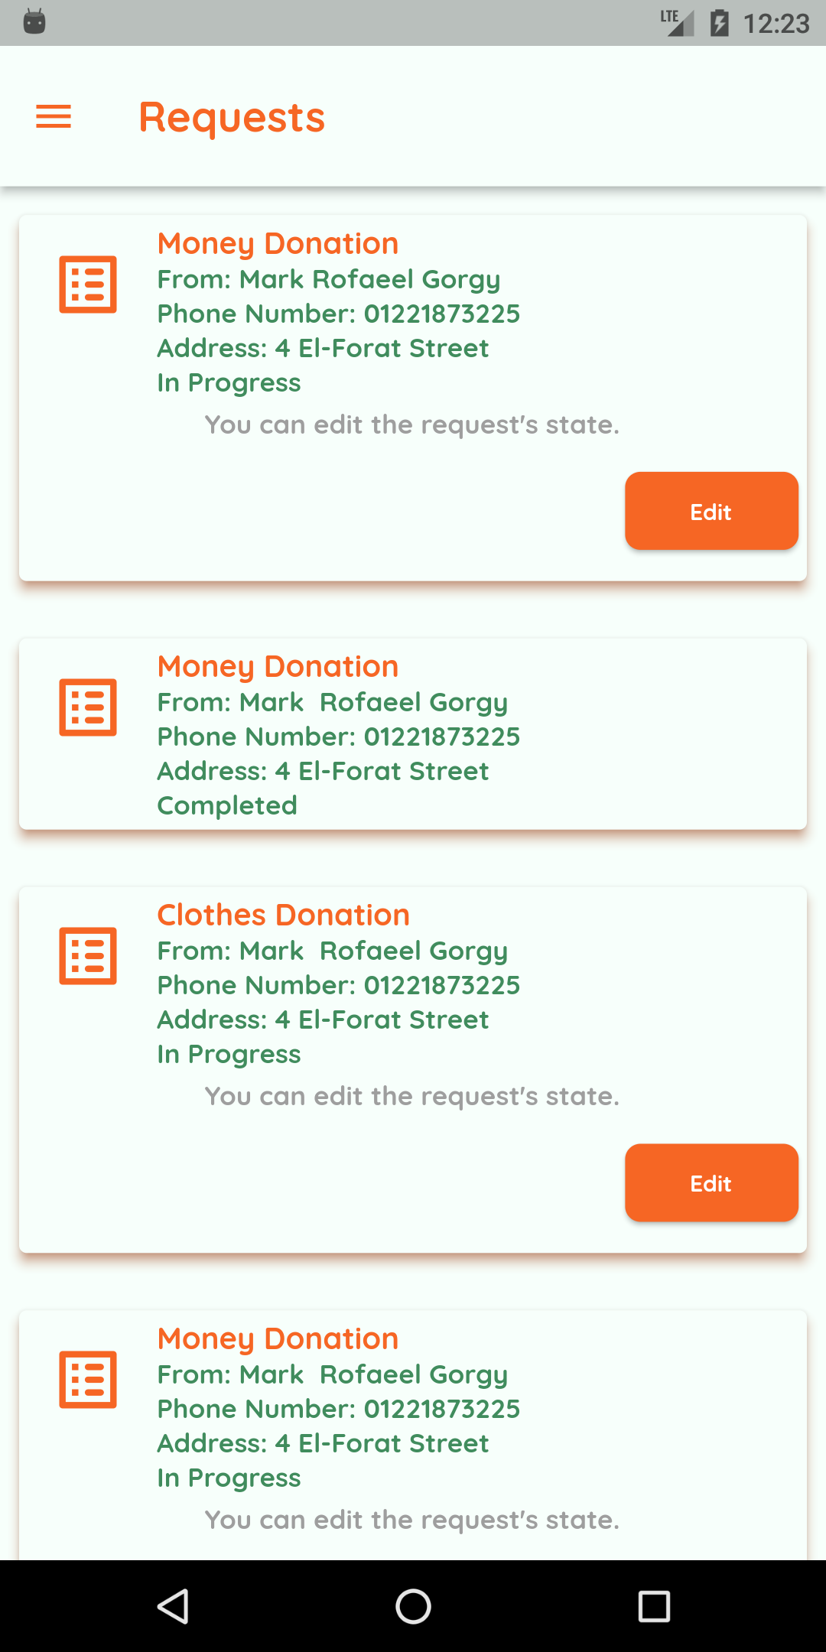
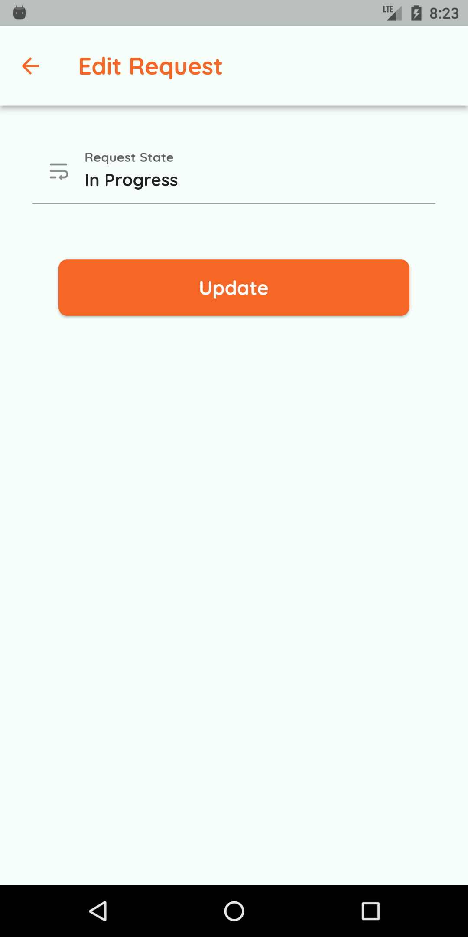
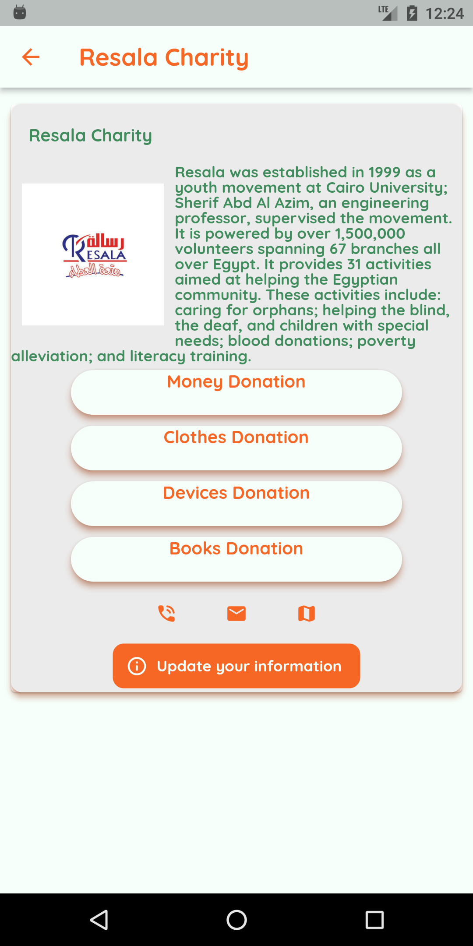
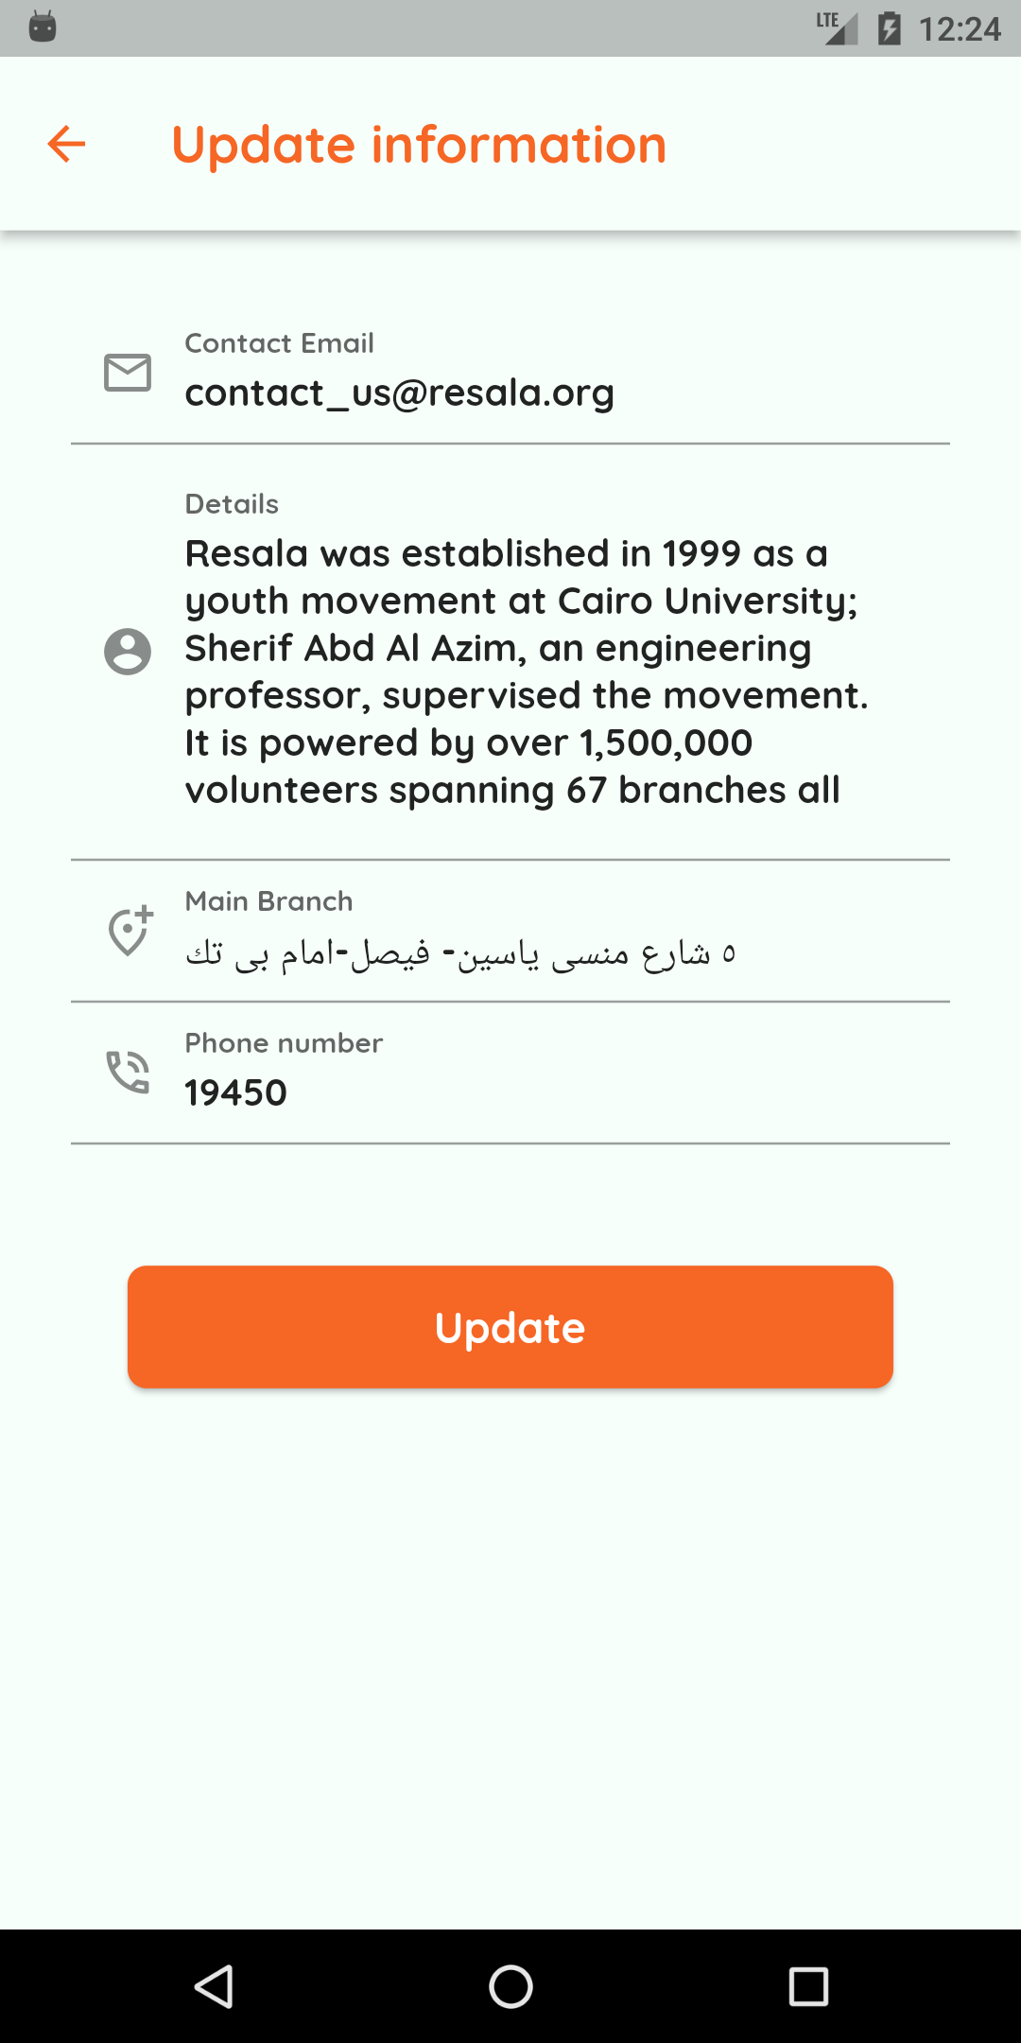
Organization’s demo

Slide 45
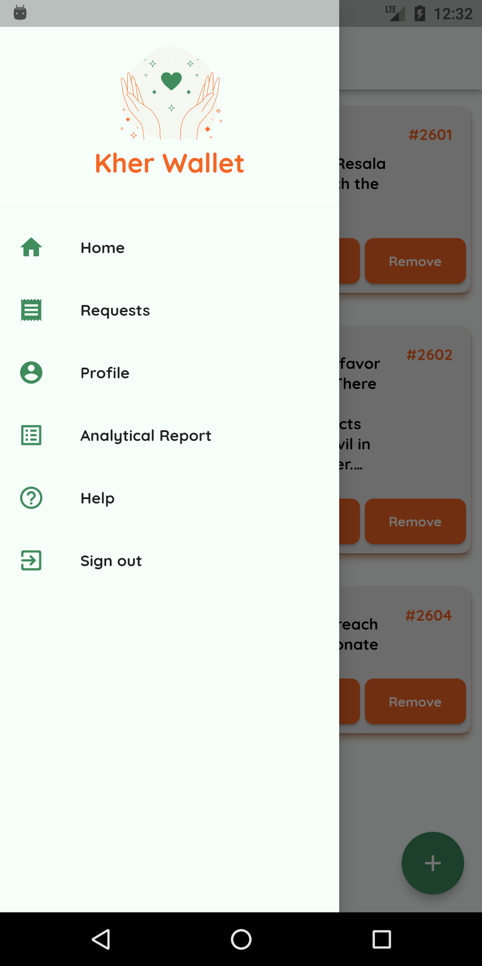
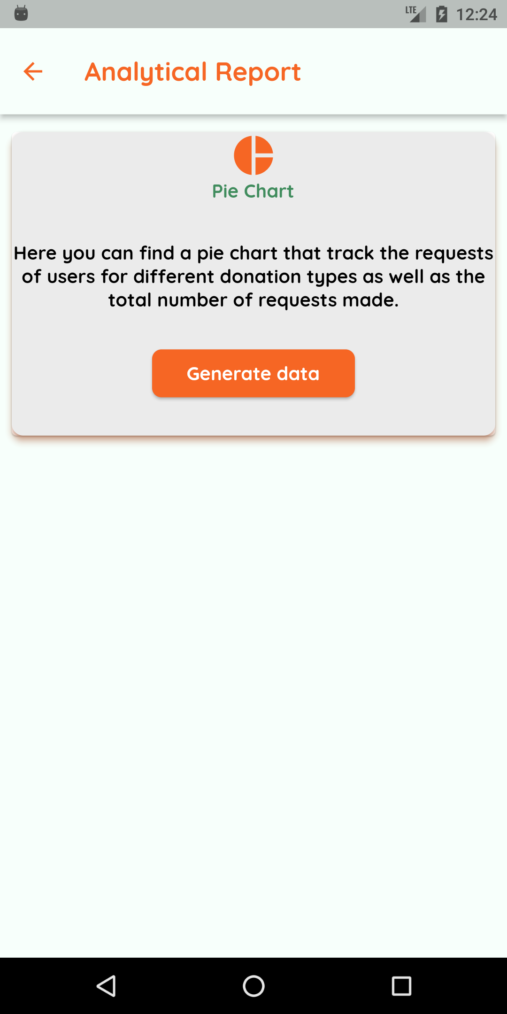


Organization’s demo

Slide 46


Slide 47
TABLE OF CONTENTS
01
02
03
Project idea
Problem significance
Project specifications
Idea description and
domain of interest.
Problems to be solved.
Requirements and important diagrams.
04
05
06
Time Plan
Demo
Conclusion
Tasks to be fulfilled.
Successive screenshots of our application.
Conclusion to what we have said.

Slide 48
06
Conclusion
Conclusion to what we have said.

Slide 49

THANKS!
Do you have any questions?
kherwallet@gmail.com

